Slide 1
Applying the Bullying Checklist and How to Report Bullying when it occurs.
Catch Me @ My Best Guidance Lesson – Friday, August 24th

Slide 2
Bullying Checklist
The Bullying Checklist is a great resource to use when trying to decide if a situation that happens is bullying or not.
Sometimes, others choose to make poor choices which can be perceived as mean but other times, those poor choices can cross the line and be identified as bullying.
Use the checklist in the following scenarios and decide if it is bullying or not.

Slide 3
Scenario #1
Lee waits for Jessie to leave their first period class every day. Lee is much larger stature and does not like Jessie. Almost every day, Lee confronts Jessie following their first period class by knocking Jessie’s books from his hands. Jessie does nothing to retaliate.
Is this Bullying?

Slide 4
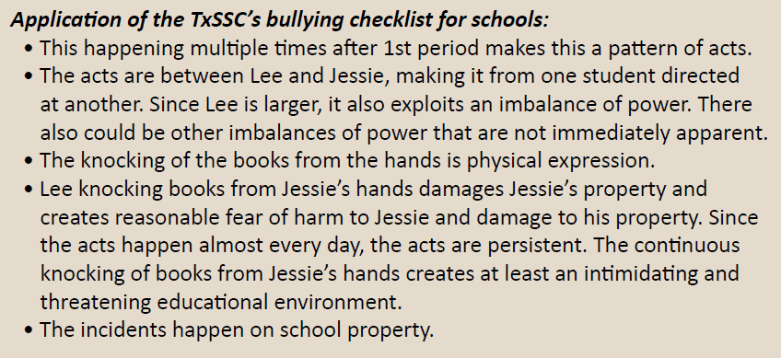
Scenario #1
Yes! According to the bulling checklist, it meets the necessary criteria to be considered bullying according to the Texas Education Code.

Slide 5
Scenario #2
Taylor and Devin communicate through text and social media every day. Taylor and Devin are both interested in dating a student named Ryan. At some point, Devin starts spreading false rumors to Ryan about Taylor, in order to get Ryan to not like Taylor. After leaving school, Devin starts texting unflattering photos of Taylor to Ryan and making social media posts “bashing” Taylor. These texts and photos, as well as social media posts are NOT done while at school, only at home or at other friends’ houses. Other students are beginning to shun Taylor at school, resulting in Taylor socially withdrawing at school and no longer wanting to attend school. When Taylor and Devin are in class together, they have to be separated, as they obviously don’t get along together in school.
Is this bullying?

Slide 6
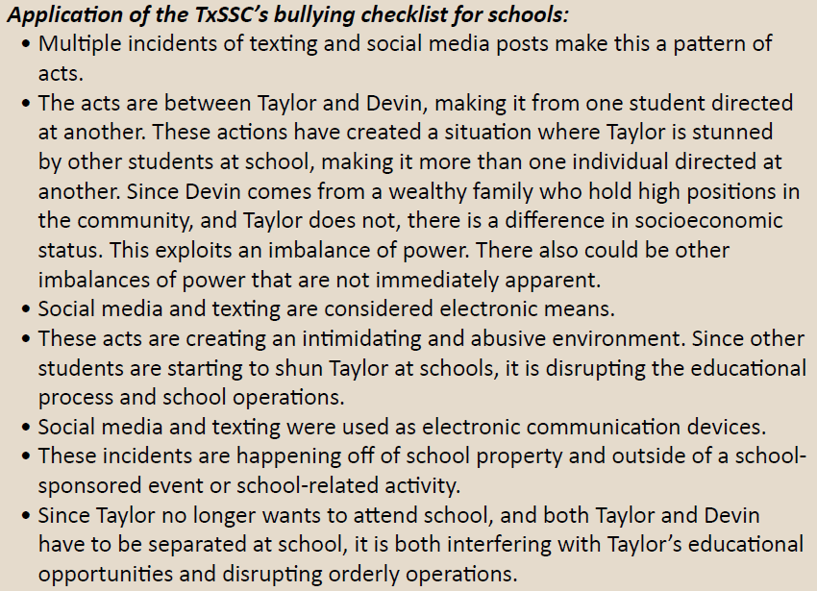
Scenario #2
Yes! According to the bullying checklist, it meets the necessary criteria to be considered bullying (Cyberbullying is bullying.)

Slide 7
Scenario #3
Jordan and Dakota are longtime friends and their families are friends as well. They are the same age and live a few blocks from each in the same neighborhood. They are both on the baseball team and both are well connected socially at school. Lately, they have been more competitive in their sports activities and have grown further apart. At times, they have been observed at school trading verbal taunts about each other and making fun of each other’s family members. No physical altercations have occurred, but they are both aligning with other friends to go “against” each other.
Is this bullying?

Slide 8
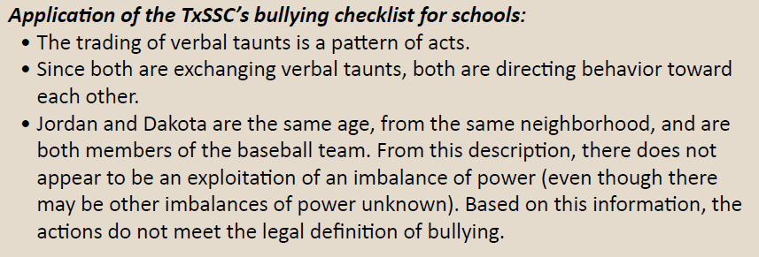
Scenario #3
No! According to the bullying checklist, it does not meet all the necessary criteria to be considered bullying. Specifically, it lacks exploiting an imbalance of power. Intervention by the counselor, administrators, or coaches would help resolve the situation.

Slide 9
Scenario #4
Logan and Cameron attend the same school and live in the same neighborhood. They ride the bus to school together every morning and afternoon. Logan is well-known around the school and has lots of friends, while Cameron is shy and does not have many. Recently, Logan started to “pick on” Cameron on the bus. He throws paper planes at him and rounds up other students on the bus to make fun of him. This has occurred for the last several weeks. Logan does not talk to Cameron while at school. Cameron has started to miss several days of school because he is afraid that Logan’s taunts will start happening while at school.
Is this bullying?

Slide 10
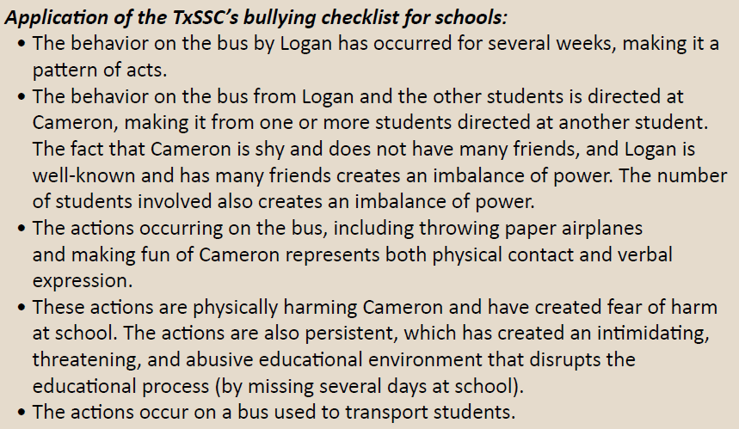
Scenario #4
Yes! According to the bullying checklist, it meets the necessary criteria to be considered bullying.

Slide 11
Scenario #5
Parker and Morgan go to the same school and walk home every day. One day, after leaving the school campus, Parker decides to tease Morgan on their walk home. Parker pushes Morgan to the ground and dumps out her backpack. Parker is much bigger than Morgan, so it was easy for her to push her down. Morgan runs home crying. Morgan’s mom has called up to the school to report that Morgan is the victim of bullying.
Is this bullying?

Slide 12
Scenario #5

Slide 13
Scenario #6
Jayden and Avery go to school together. Jayden is an 8th grader and Avery is a 7th grader. They play basketball together every Saturday. One Saturday at the basketball court, Jayden stole Avery’s basketball. When Avery confronts Jayden, Jayden denies doing it. That evening, Avery gets on Twitter and notices that Jayden posted a short video of Avery missing a basketball shot with the caption “This is what sucking at bball looks like.” Avery notices that the video has been shared over 50 times by classmates and others. On Monday morning, students in school were laughing at Avery while walking through the halls. Avery has been unable to focus in class because of the laughing.
Is this bullying?

Slide 14
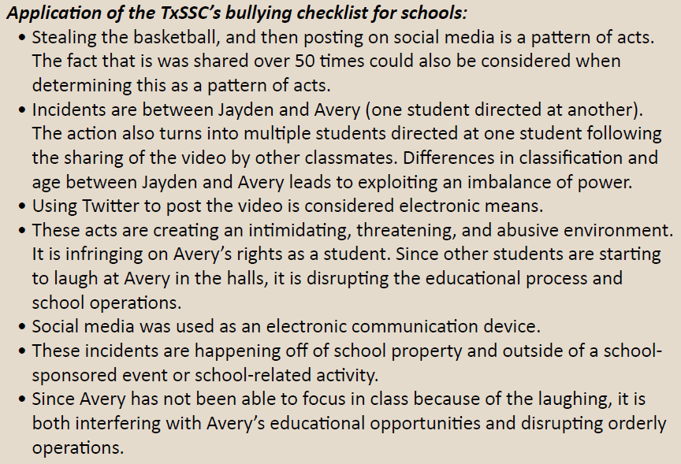
Scenario #6
Yes! According to the bullying checklist it meets the necessary criteria to be considered bullying.

Slide 15
How To Report Bullying
If you think you are being bullied or have witnessed a friend/classmate being bullied, you need to report it. You can:
Tell a trusted adult (mom, dad, aunt, grandmother, etc.)
Tell a teacher or coach
Complete a bullying form in the CMS counseling office
Go to www.cisd.org and click on “Quick Tips” to complete an online bullying report.

Slide 16
Quick Tips – www.cisd.org

Slide 17
Quick Tips – www.cisd.org

Slide 18
Quick Tips – www.cisd.org

Slide 19
Quick Tips – www.cisd.org
You can report other things on Quick Tips in addition to bullying:
Bullying
Bus Concern
Campus Safety/Security Concerns
Drug or Alcohol Violation
Fighting
Misconduct/Inappropriate Behavior
Online Harassment/Bullying
Robbery
Student Health Concern
Threat of Violence
Vandalism
Weapons Violation

Slide 20
#TEAMCMS
#TCC

Slide 21
#CatchMe@MyBest

