Slide 1
ARTTALK Chapter 5 Line

Slide 2
Before we start, here is an artist that uses line with sand painting.
https://www.youtube.com/watch?v=jWAa7EigJRs

Slide 3
Objectives for Chapter 5:
Observe the lines in your environment more closely.
Name the different kinds of lines.
Tell the five ways lines can vary in appearance.
Understand the expressive qualities of meanings of different lines in works of art.
Use lines to make contour, gesture, and calligraphic drawings.
Use lines to change values.

Slide 4
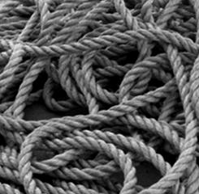
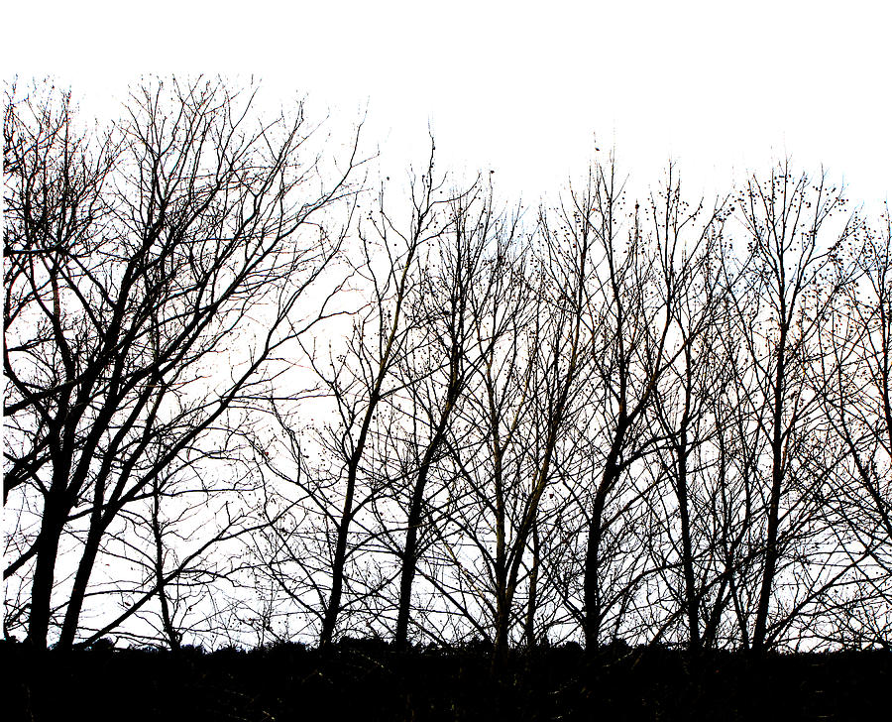
Line
Line is an Element of Art.
Lines are all around us everyday. When you write, you are using lines.
If you wait in line for something, you are a part of a line.
How many lines do you see in each picture?

Slide 5
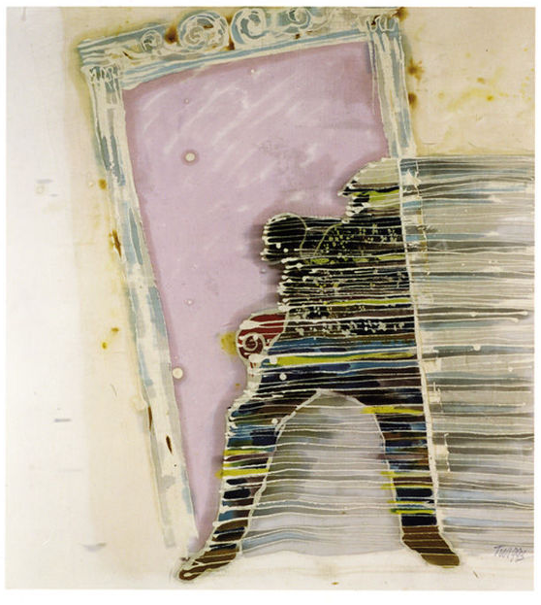
Leo F. Twiggs. East Wind Suite: Door. 1989. Batik: Dyes and wax resist on cotton. 24” x 20”.
Study this artwork.
This work is called Door. Do you see a door?
What kind of lines define the dark shape? What does this imply?
How does the artist’s use of line affect the mood of this painting?
What feeling do you get about what is happening?

Slide 6
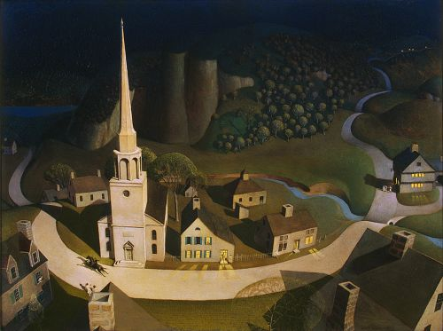
What is line?
A line is a mark drawn with a pointed, moving tool.
Artists use lines to control your eye movement.
Lines can lead your eyes into, around, and out of visual images.
Grant Wood. Midnight Ride of Paul Revere. 1931. Oil on Masonite. 10” x 40”.

Slide 7
A line has width as well as length, but the width of a line is usually small compared to its length.
A line is one-dimensional. Its one dimension is its length.
Dimension is the amount of space an object takes up in one direction.
Artist often think of line as the path of a dot through space.
Your eyes follow the movement of a line.

Slide 8
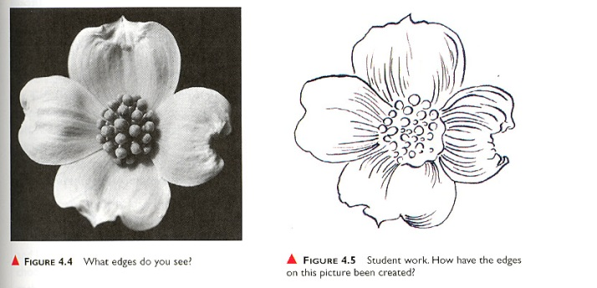
Notice the difference between the photo on the left, and the drawing on the right.
Lines are being used here to show the edges of each shape.
Outline is a line that shows or creates the outer edges of a shape.

Slide 9
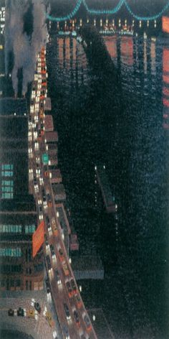
Yvonne Jacquette. East River View at Night. 1978. Pastel on Paper. 19” x 23”
Study this artwork.
The series of white dots representing car headlights creates lines that pull your eyes up into the picture.
At first the dots are widely spaced, but as you follow them, they get closer and closer together until the line is almost solid.
Implied lines are a series of points that the viewers eyes automatically connect.
Implied lines are only suggested; they are not real.

Slide 10
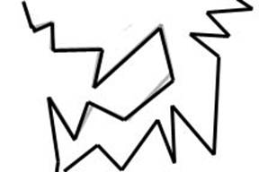
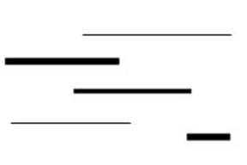
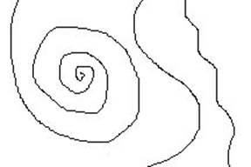
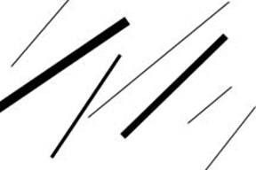
Kinds of Lines
There are five basic kinds of lines: vertical, horizontal, diagonal, curved, and zigzag.
Vertical lines- lines that move up and down, without any slant. They are perpendicular to the horizon
Horizontal lines- lines that are parallel to the horizon, without any slant.
Diagonal lines- lines that slant. They look like they are either rising or falling.
Zigzag lines- lines made from a combination of diagonal lines. The diagonals form angles and change direction suddenly.
Curved lines- Lines that change direction gradually.

Slide 11
Line Variation
Lines vary in appearance in five major ways.
Length. Lines can be long or short.
Width. Lines can be wide or thin.
Texture. Lines can be rough or smooth.
Direction. Lines can move in any direction, such as vertical, horizontal, or diagonal.
Degree of curve. Lines can curve gradually or not at all, becoming wavy, or form spirals.
Length
Width
Texture
Direction
Degree of curve

Slide 12
These five kinds of lines can be combined in many, many ways.
The media, tools, and surfaces used to make lines affect the way a line looks.
A line drawn with chalk on a chalkboard looks smoother than a line drawn with chalk on a sidewalk.
Artists use different tools and materials to create different types of lines.

Slide 13
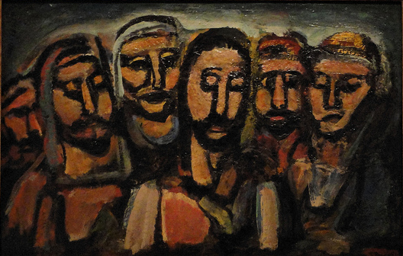
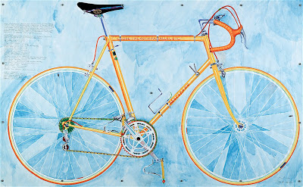
Notice the different ways that lines are used in these two paintings.
How many different line directions and variations do you see?
Georges Rouault. Christ and the Apostles. 1937-38. Oil on canvas. 26 x 40”
Greg Curnoe. Mariposa 10 Speed. 1973. Watercolor over graphite on paper. 40 x 72”.

Slide 14
What Different Lines Express
Depending on its direction, a line can communicate, or express, different ideas or feelings.
Vertical lines can make objects look taller. For example, vertical lines on a wall can make low ceilings seem higher.
Clothing designers use lines to manipulate how you see someone.

Slide 15
Vertical Lines
Vertical lines are static, or inactive. They appear to be at rest. They express stability.
Vertical lines can also give an impression of dignity, poise, stiffness, and formality, as shown in this painting.
Dan Namingha. Blessing Rain Chant. 1992. Acrylic on canvas. 78 x 120”. Niman Fine Art , Santa Fe, New Mexico.

Slide 16
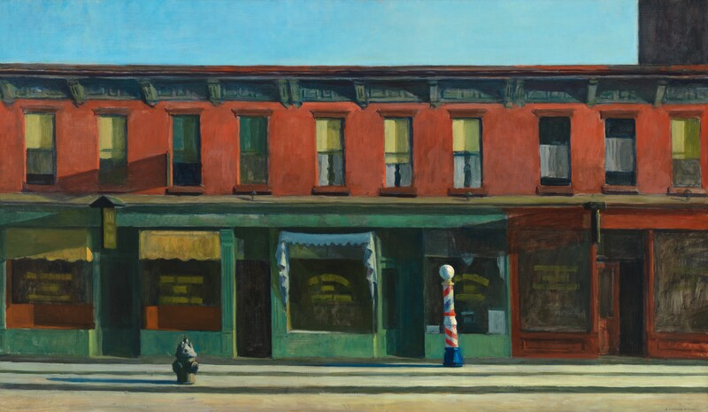
Horizontal Lines
Horizontal lines are also static. They express feelings of peace, rest, quiet, and stability.
Horizontal lines make you feel content, relaxed, and calm.
Strong horizontal lines create a sense of calm on this empty street.
Edward Hopper. Early Sunday Morning. 1930. Oil on canvas. 35 x 60”.

Slide 17
Diagonal and Zigzag Lines
Unlike vertical and horizontal lines, diagonal and zigzag lines are active lines.
They communicate action and movement because they seem to be pulled one way or the other.
They are not at rest.

Slide 18
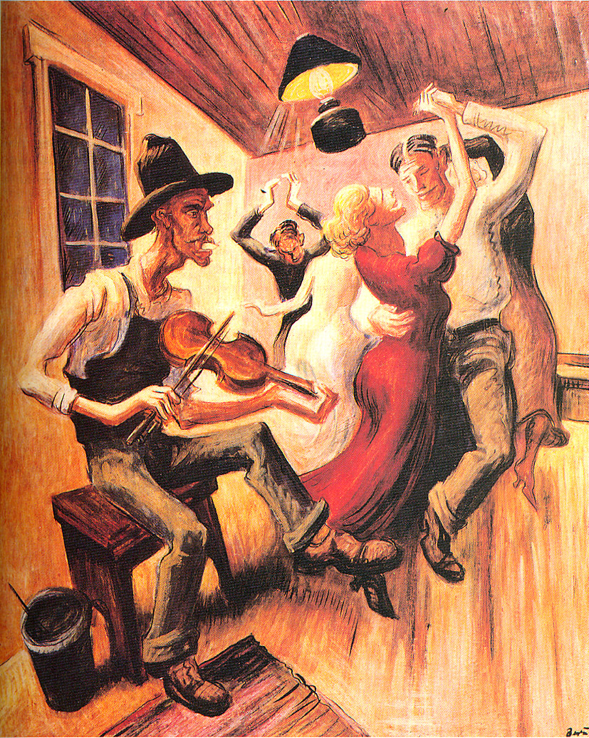
Diagonal Lines
Diagonal lines express instability, tension, activity, and excitement.
They appear to either rise or fall, sometimes making the viewer feel uncomfortable.
Artists use them to add tension or to create an exciting mood.
When two diagonals meet and seem to support each other, as in the roof of a house, they can appear stable.
Thomas Hart Benton. Country Dance.1929. Oil on gessoed canvas. 30 x 25”. Private collection.

Slide 19
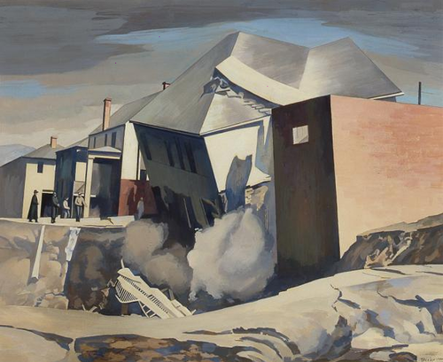
Zigzag Lines
Zigzag lines create confusion. They are extremely active and evoke feelings of excitement and nervousness.
The degree of intensity is indicated by the direction of the zigzag. Horizontal zigzags are less active than vertical ones.
Sheeler uses diagonal lines to indicate the houses are sliding into the flood waters. Notice how the houses that have not been affected by the flood are still vertical.
Charles Sheeler. Catastrophe No. 2. 1944. Tempera on panel. 17 x 14”

Slide 20
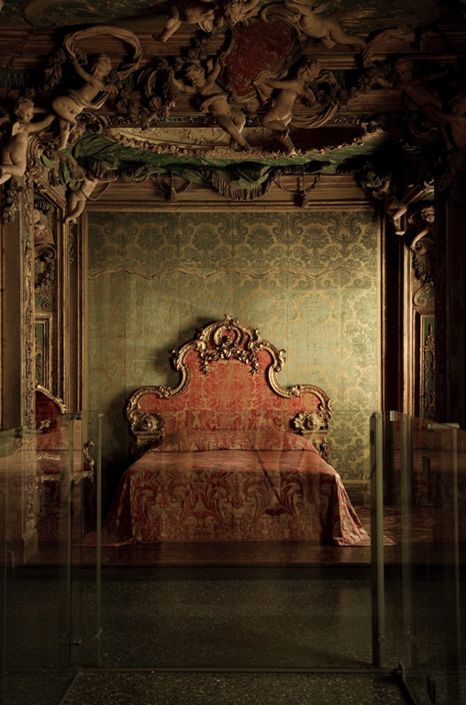
Curved Lines
Curved lines change direction, so they too express activity.
How much activity they express depends on the type and direction of the curve.
The less active the curve, the calmer the feeling.
All curved lines are graceful.
Curved lines are often used in interior decoration to suggest a feeling of luxury.
Spiral curves wind around a central point and are hypnotic.
Italian, Venice. Bedroom from the Sagredo Palace. C. 1725-35.

Slide 21
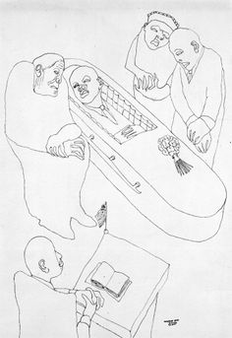
Contour Drawing
A contour line defines the edges and surface ridges of an object.
A contour line also creates a boundary separating one area from another.
Benny Andrews, Burial (Georgia). 1965. Pen and ink.

Slide 22
Gesture Drawing
A gesture is an expressive movement.
The purpose of drawing gestures is to capture the feeling of motion.
A gesture drawing does not use a lot of detail.
Drawn quickly, loosely, recklessly.
May resemble scribbles.
Jacopo Tintoretto. Standing Youth with His Arm Raised, Seen from Behind. Black chalk on laid paper. 15 x 9”.

Slide 23
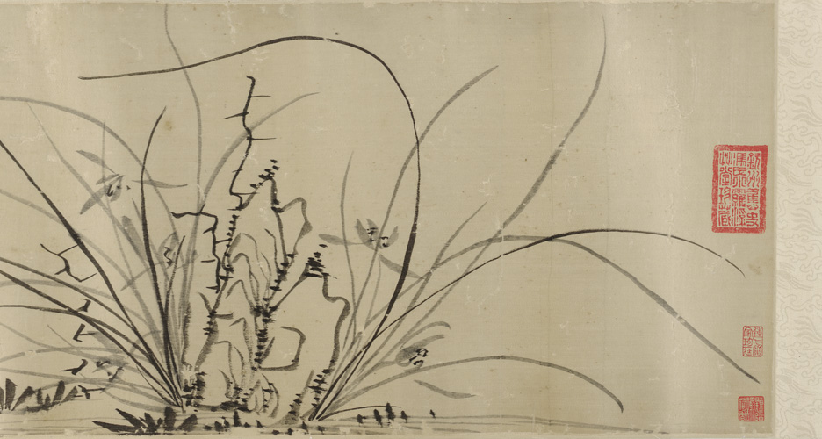
Calligraphic Drawing
Calligraphy means beautiful handwriting.
Often associated with Asian writing and art.
Calligraphic lines are usually made with brushstrokes that change from thin to thick in one stroke.
Gu Mei. Orchids and Rocks. 1644. Ming dynasty. Detail of handscroll. Ink on paper. 11 x 68”.

Slide 24
Line and Value
Value is the Element of Art that describes the darkness or lightness of an object.
Value depends in how much light a surface reflects.
A surface has a dark value if it reflects little light.
It has a light value if it reflects a lot of light.
Value is closely related to the way every element of art and principle of design works.

Slide 25
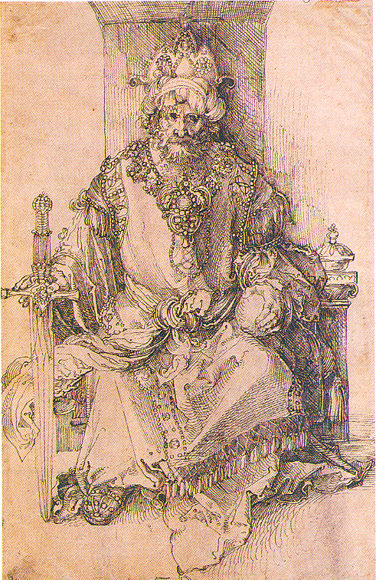
Crosshatching is the technique of using crossed lines for shading.
The value created by groups of line depends on many things: the number of lines, the size of spaces between the lines, the media, and the tools.
Albrecht Durer. An Oriental Ruler Seated on His Throne. C.1495. Pen and ink. 12 x 7 ¾”.

Slide 26
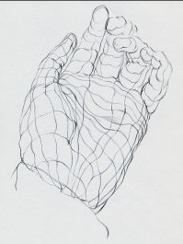
A Cross-contour line is a line that crosses and defines a surface between the edges or between the contour lines.
They are perpendicular to the contour lines.

Slide 27
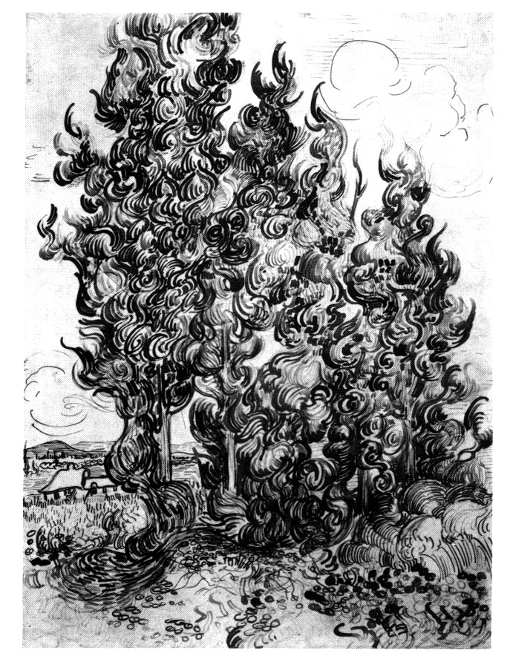
Line and Movement
The different ways in which lines are made, can create the feeling of movement.
Shown is “Grove of Cypress” by Vincent Van Gogh.
The lines used to create this piece give the feeling that the trees are in the wind.

