Slide 2
Objectives
To understand how to appropriately use forensic science tools.
To understand how to take accurate measurements with forensic science tools.

Slide 3
Main Menu
Evidence Collection Tools
Evidence Analysis Tools
Using a Microscope Video Segment
Evidence Preservation Tools

Slide 5
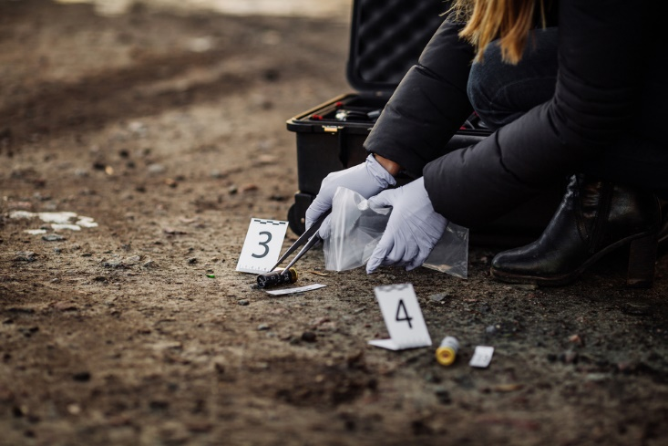
Tools in Forensic Science
Are used to:
collect evidence from a crime scene
analyze evidence in forensic science labs
store and preserve evidence

Slide 6
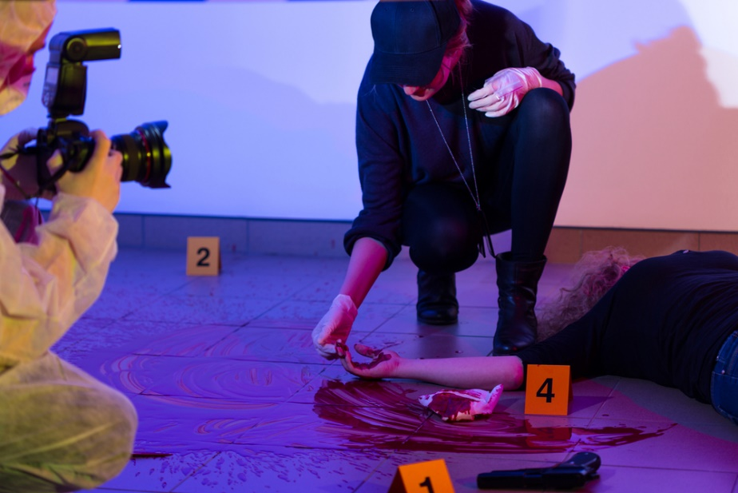
Evidence Collection Tools
Include equipment used to secure the crime scene such as:
crime scene barricade tape
personal protective equipment
evidence markers
crime scene lights
crime scene documentation

Slide 7
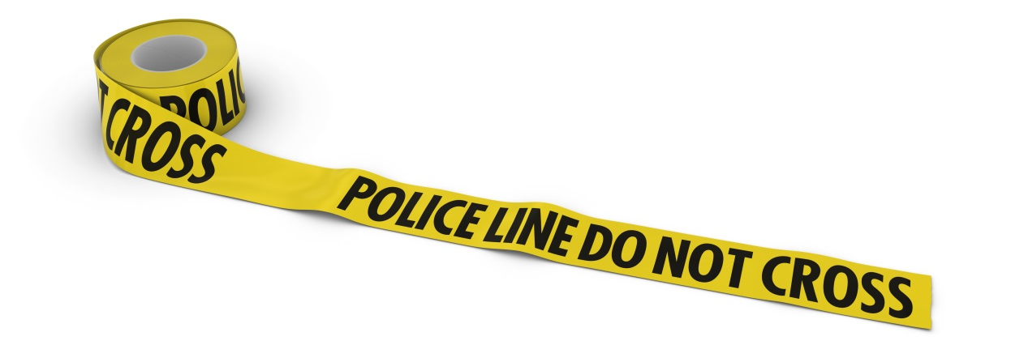
Barricade Tape
Is yellow tape used to mark off crime scene areas
Is used to keep unauthorized individuals from entering the crime scene and potentially harming evidence

Slide 8
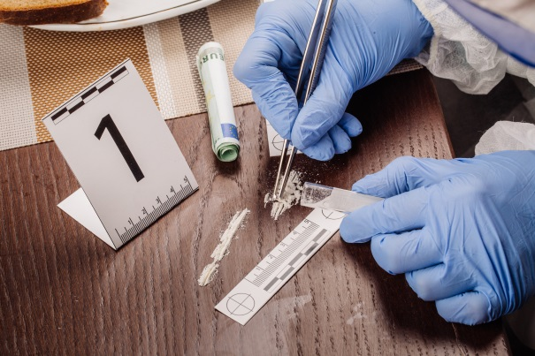
Personal Protective Equipment
Provides a barrier to keep biological or chemical hazards from contacting the skin or eyes
Prevents contamination of the crime scene

Slide 9
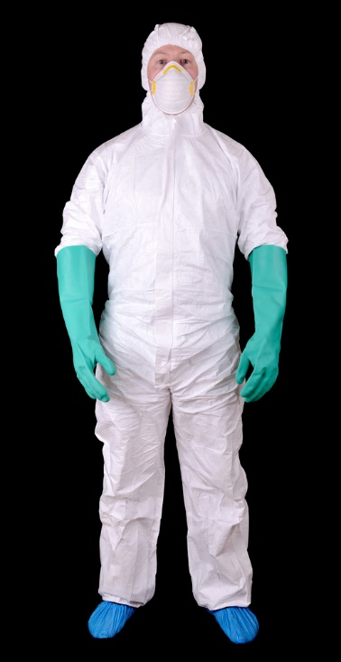
Personal Protective Equipment
Includes:
disposable gloves
masks
booties
hair covering
hair nets
hats
overalls
eye protection
glasses
goggles

Slide 10
Evidence Markers
Are numbered or lettered markers placed next to each piece of evidence at the crime scene
Are used to keep organized identification records of evidence when photographing
Include markers in the form of:
small A-frame tents
cones
flat L-shaped pieces of plastic
flags
adhesive number sheets

Slide 11
Crime Scene Lighting
Is used when searching crime scenes in dimly lit places or at night
Includes light sources such as:
flashlights
glow sticks
tall standing lights
evidence marker illuminators
small lights placed under evidence cones or tents for easy visibility

Slide 12
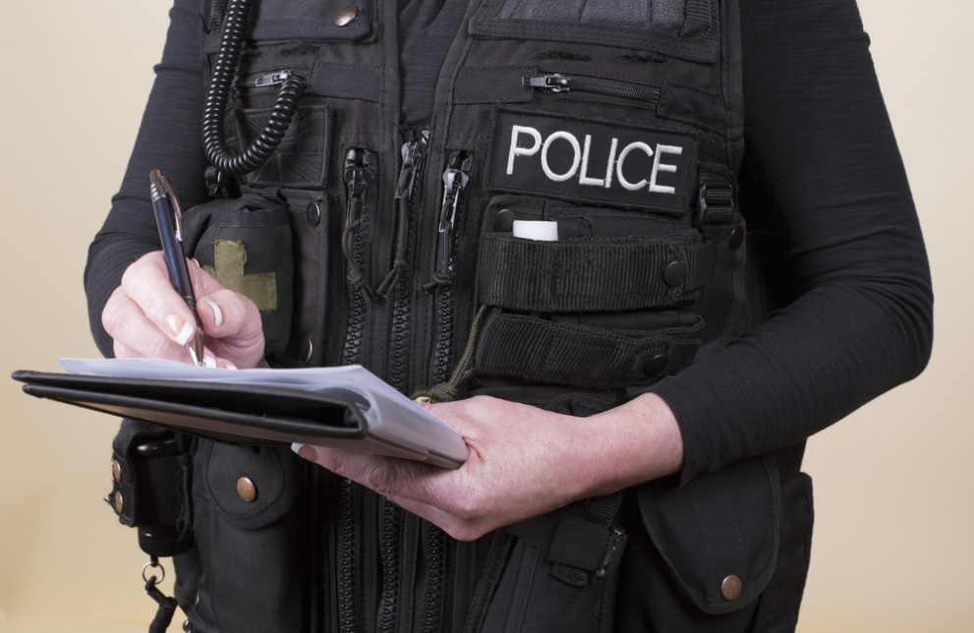
Crime Scene Documentation Tools
Are used to record as many details as possible regarding the crime scene and evidence
Includes items such as:
notebooks and writing utensils
cameras

Slide 13
Notebooks & Writing Utensils
Are used to take handwritten notes
notetaking should begin immediately when arriving on a crime scene
Should be used to record information such as:
date and time
victim and witness statements
general description of the scene
crime scene sketches
evidence chain of custody

Slide 14
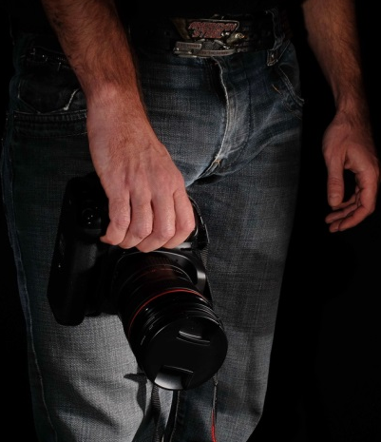
Cameras
Are handled devices used to record visual images
Are used to record:
the crime scene before evidence is removed
evidence found at the crime scene

Slide 15
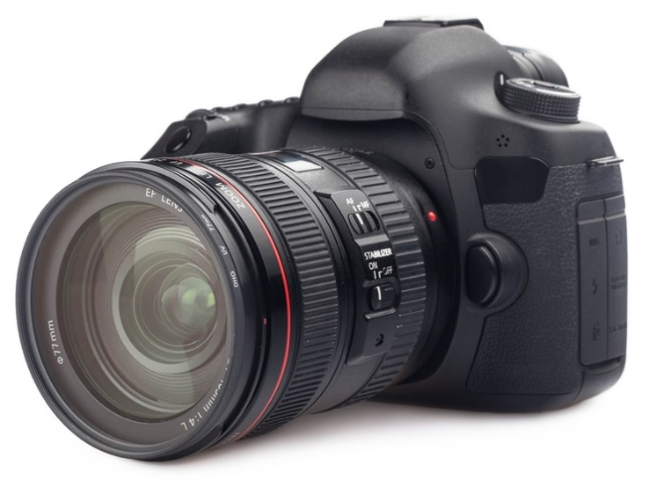
Cameras
Includes:
photography:
still images useful for comparing evidence found at the crime scene to possible suspect evidence
used to take pictures of objects with rulers to show actual size
video cameras
moving visual images
shows the structure of the crime scene

Slide 16
Evidence Collection Tools
Are used to collect evidence from a crime scene
Include:
scalpels
forceps, tweezers and needle nose pliers
vacuum cleaners with special filters
tape
combs
brushes
fingerprint powders
magnifying glass

Slide 17
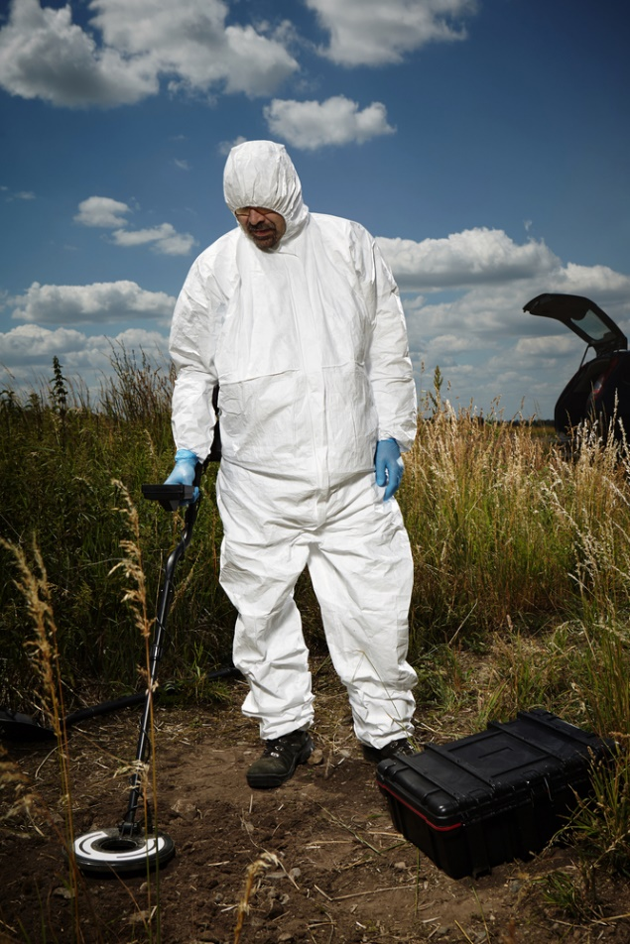
Evidence Collection Tools
Include:
sterile cloth swabs
UV light
smear slides
scissors
shovel
sifting screen
metal detectors
molds

Slide 18
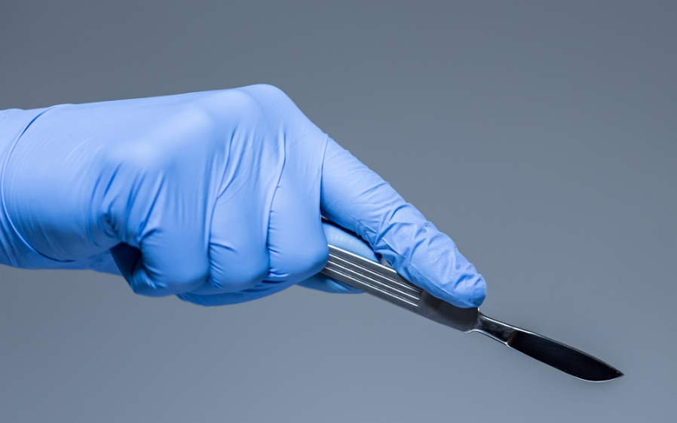
Scalpels
Are knives with a small flat blade at the end of a handle
Are used to collect evidence at crime scenes by:
scraping objects from flat surfaces
cutting around objects containing evidence

Slide 19
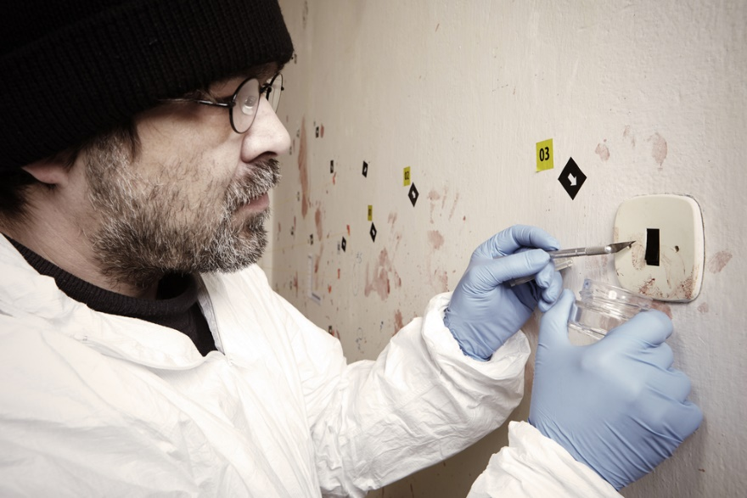
Scalpels
Are used to collect evidence including:
trace evidence
bodily fluids
Should be used with caution because of the sharp tip
Should be sterile before use

Slide 20
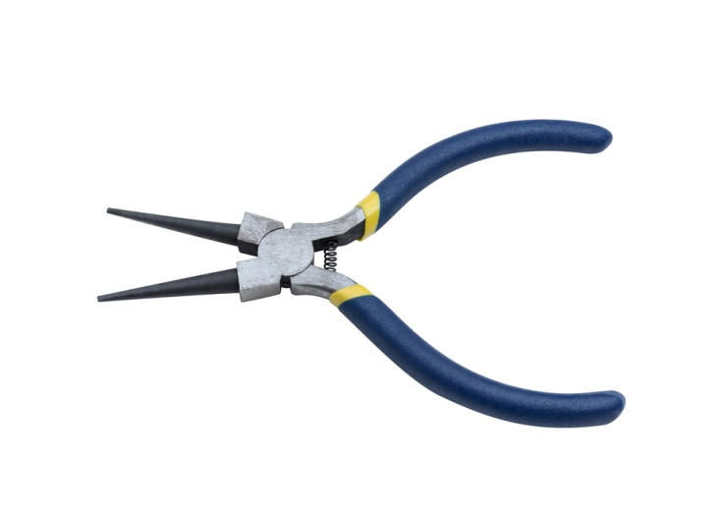
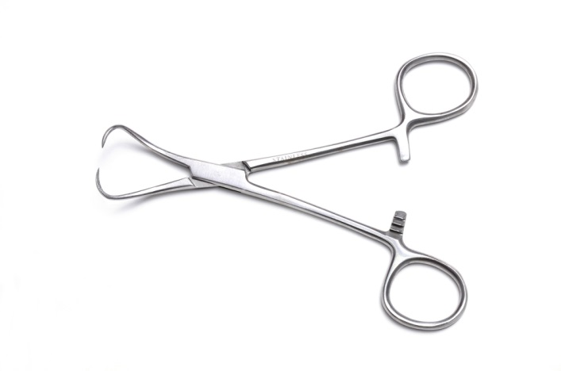
Forceps, Tweezers & Needle Nose Pliers
Are tools consisting of two prongs with small pointed ends which are pressed together to pick small pieces of evidence off an object
Are used to collect evidence such as
trace evidence
ballistic evidence
Should be sterile before use

Slide 21
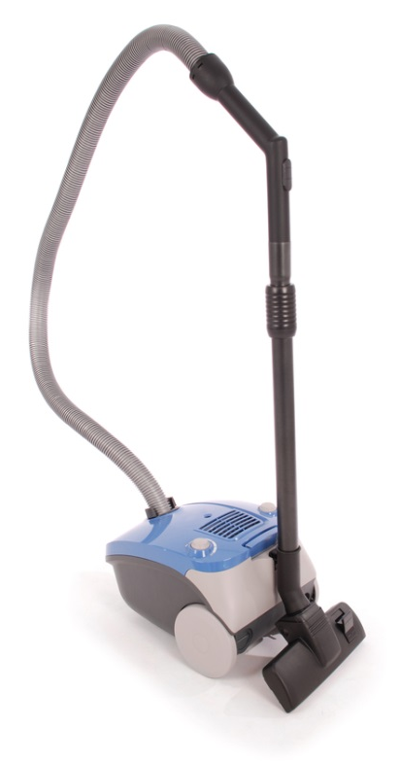
Vacuum Cleaners With Special Filters
Use filter traps to collect very small evidence
Are used to pick up several items at once
Consists of removable filters which are placed in evidence bags and transferred to forensic science labs

Slide 22
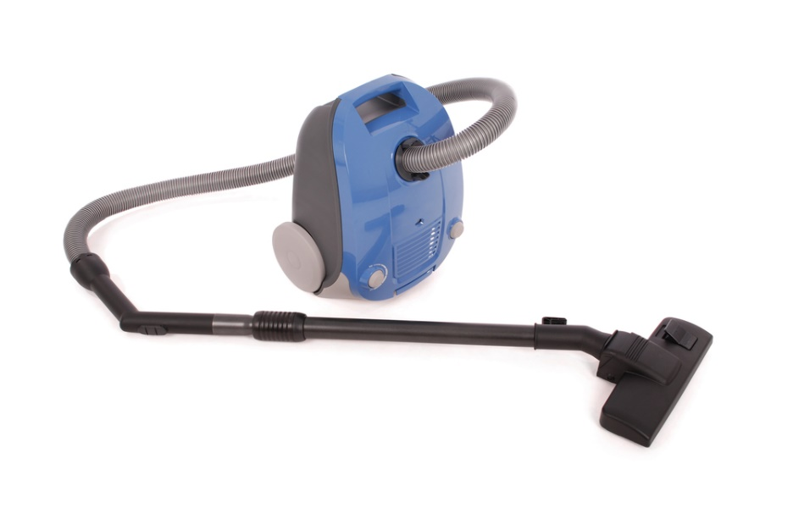
Vacuum Cleaners With Special Filters
Should be used to collect possible evidence in areas such as:
furniture cushions
carpets
car interiors

Slide 23
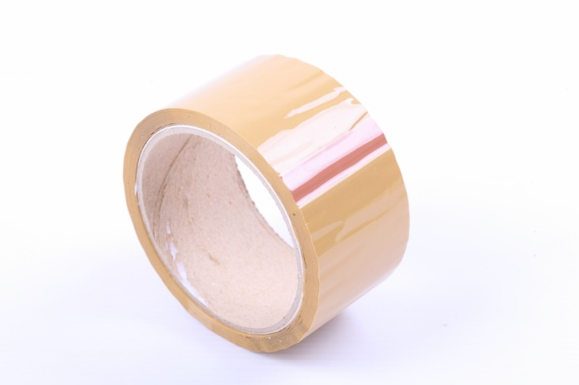
Tape
Is plastic adhesive strips used to lift evidence from an object
Should be pressed down on the surface containing evidence and lifted to immediately be placed on a backing card
prevents foreign items sticking to tape with evidence samples

Slide 24
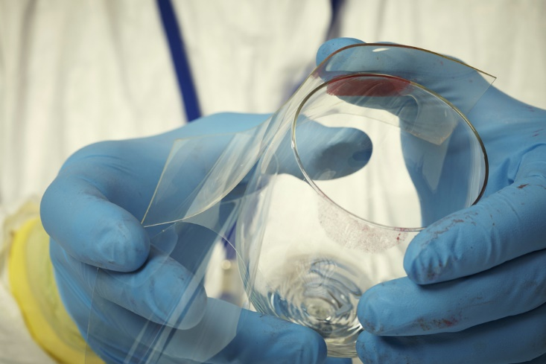
Tape
Is used to collect evidence such as:
trace evidence
ballistics
bodily fluids
fingerprints
Should be used wearing gloves

Slide 25
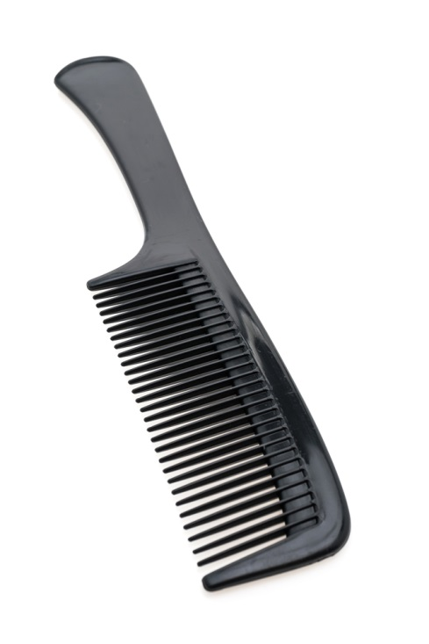
Combs
Are flat strips of narrow teeth used collect evidence from a persons hair including foreign objects deposited by an assailant such as:
hair
dandruff
fibers
DNA
bodily fluids

Slide 26
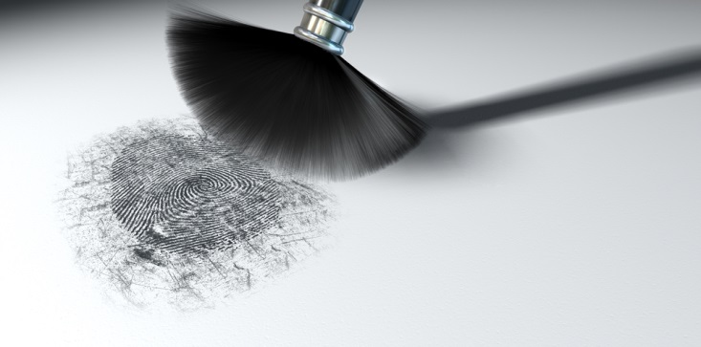
Brushes
Are bristles of hair or wire set in bundles
Are used to:
clean or dust off evidence
gently remove dirt from around a buried object
gently apply powder on surfaces to identify fingerprints
transfer trace evidence samples

Slide 27
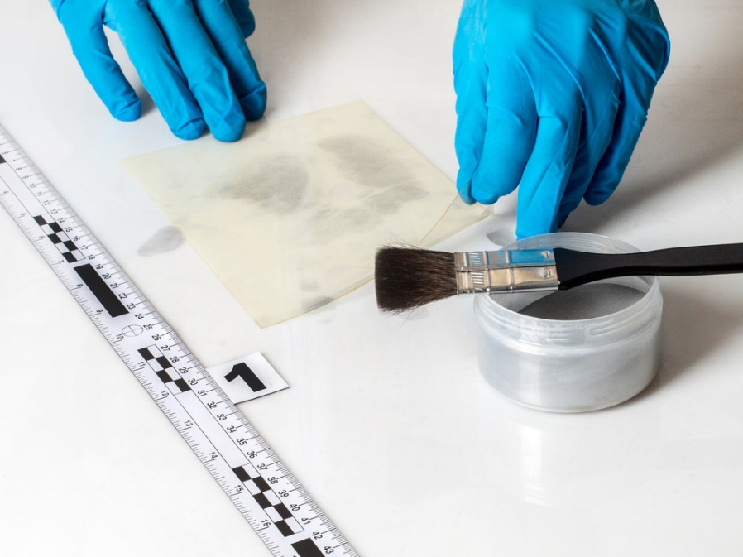
Fingerprint Powders
Are very fine, dry particles used to find latent fingerprints by dusting over objects with brushes
Adhere to moisture found in latent prints and illuminate them making them visible

Slide 28
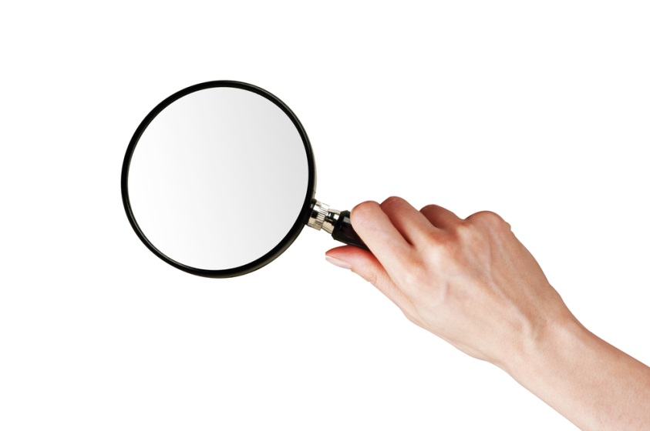
Magnifying Glass
Is a handheld lens set in a frame which produces an enlarged image of an object when looked through
Is used in crime scene investigation to find small pieces of evidence

Slide 29
Sterile Cloth Swabs
Are small pieces of absorbent material attached at the end of a stick
Are pressed or rubbed against an object containing evidence to collect it
Are used to collect evidence including:
trace evidence
bodily fluids
ballistic evidence

Slide 30
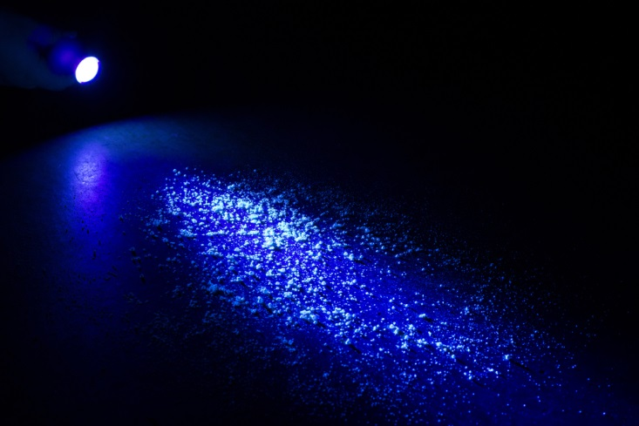
UV Light
Is an invisible form of electromagnetic radiation which carries more energy than regular light
Helps identify fluids not visible to the naked eye by creating a fluorescent illumination
Fluorescent: strikingly bright, vivid or glowing

Slide 31
Smear Slides
Are flat rectangular pieces of glass used to hold evidence
Secures evidence with a plastic slip over the top
Should be labeled
Can be used to collect evidence such as:
hair
bodily fluids
trace evidence
Should be handled wearing gloves

Slide 32
Scissors
Are a cutting instrument consisting of two blades and a ring shaped handle which pivots and cuts against the other
Are used to cut out pieces of an object containing bodily fluid samples or gunshot residue without damaging the sample

Slide 33
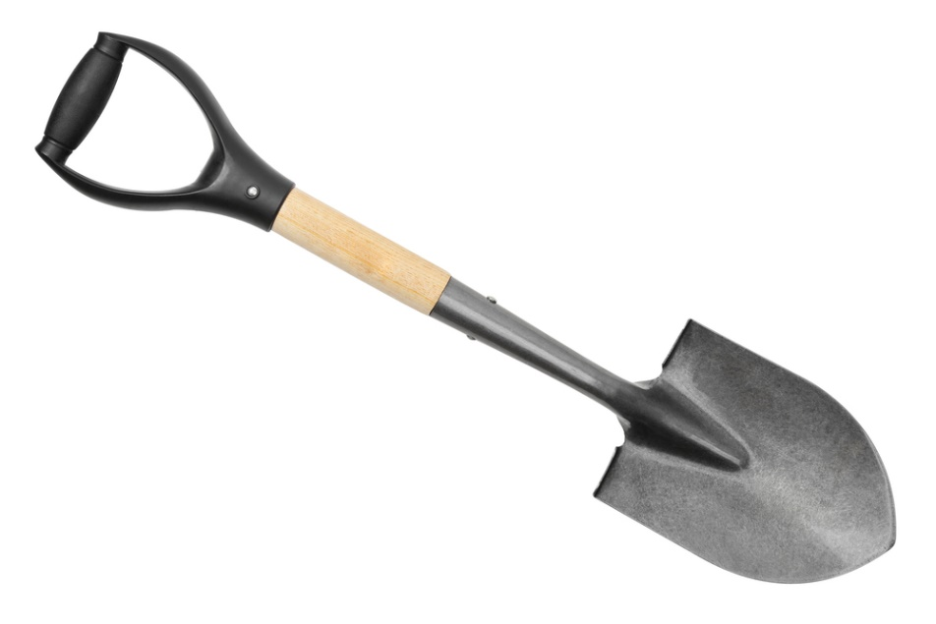
Shovel
Is a digging instrument with a broad blade or scoop at the end of a handle
Is used to unearth evidence which has been buried

Slide 34
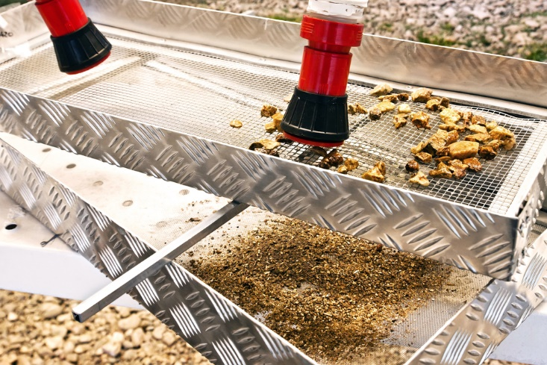
Sifting Screen
Is a wire screen set in a frame
Is used to filter evidence from dirt

Slide 35
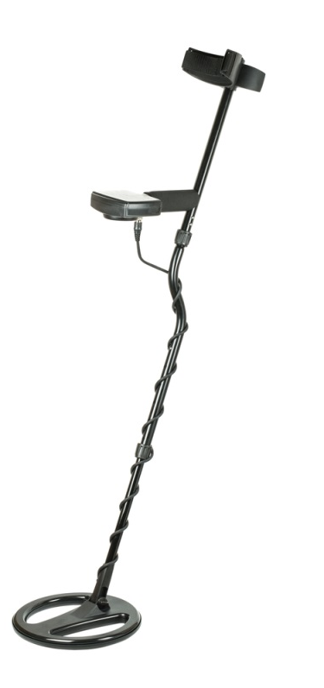
Metal Detectors
Are electronic devices used to detect metal objects by sweeping the device over an object or the ground
Are used to locate evidence containing metal which has been hidden or buried

Slide 36
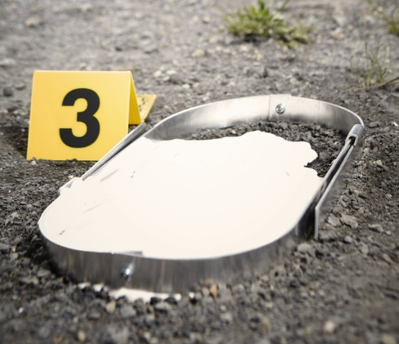
Molds
Are hollow frames which hold a particular shape
Are used to collect impression evidence such as:
footprints
tire tracks

Slide 37
Molds
Include:
3-D
a substance is poured into the impression, hardened and then removed, providing a cast of the print
2-D
an adhesive strip is placed over the impression left at the crime scene and lifted off to create a 2-D print of the pattern

Slide 39
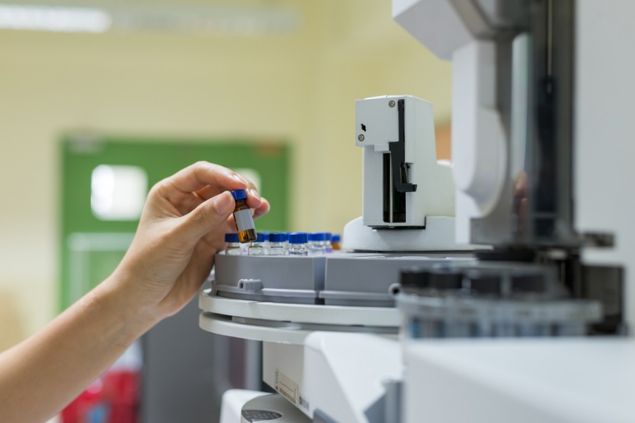
Evidence Analysis Tools
Include:
microscopes
macrophotography
gel electrophoresis apparatuses
gas chromatographers
spectroscopes
mass spectrometers
toxicology
vacuum metal deposition
x-ray machines

Slide 40
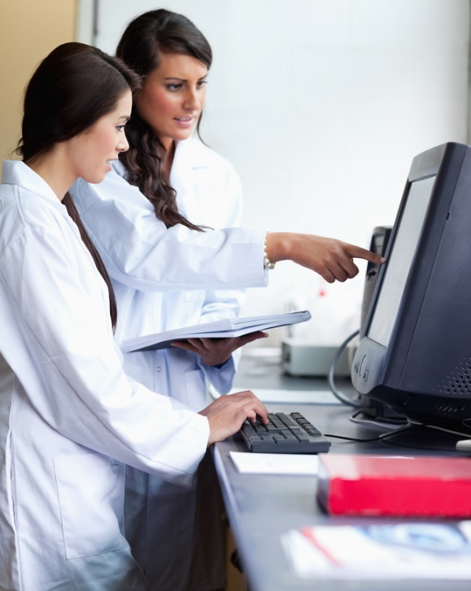
Evidence Analysis Tools
Includes:
trajectory analysis software
computer software
measurement tools
hot plates
prepared slides
stereoscopes
micropipettes

Slide 41
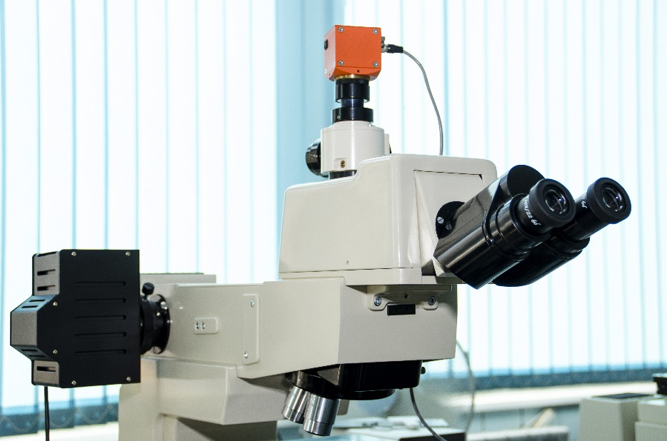
Microscopes
Are optical instruments used for viewing very small objects
Include types such as:
stereomicroscope
compound microscope
polarizing light microscope
comparison microscope
scanning electron microscopes

Slide 42
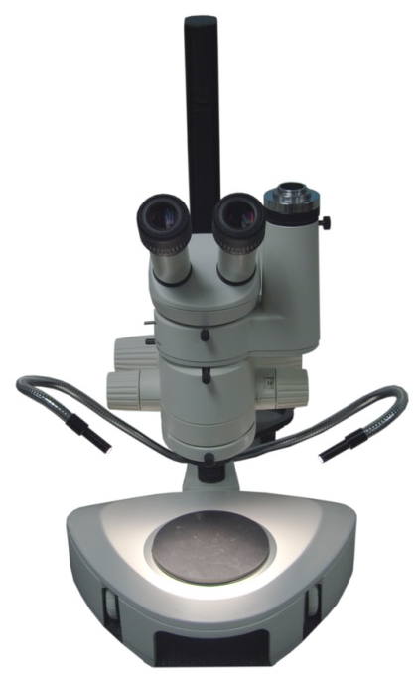
Stereomicroscopes
Are a binocular microscope which provides a relatively low-power view of the subject
Feature a set of optics for each eye which provide views at slightly different angles producing a 3-D visualization
Are used to:
study the surface of solid specimens
magnify objects during dissection or surgery

Slide 43
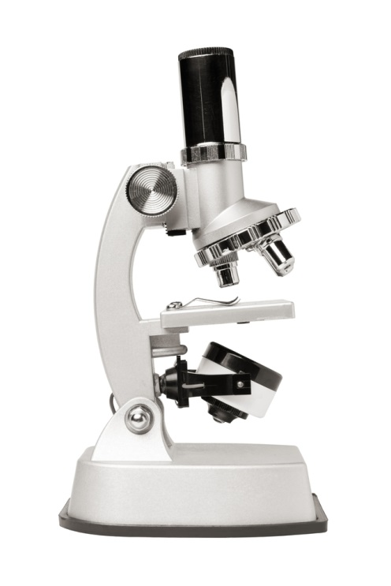
Compound Microscopes
Are microscopes with a two lens systems and an eyepiece, mounted in a tube which produces very high magnification
Consist of a rotary lens piece used for adjusting magnification
Are used to:
analyze micro-organisms
analyze cells and tissue

Slide 44
Polarized Light Microscopes
Produce a centralized light source focused on the item
Are designed to observe and photograph specimens which are visible primarily due to their optically anisotropic character
Consists of:
polarizer
positioned in the light path
analyzer
positioned in the optical pathway
Anisotropic: exhibiting properties with different values when measured in different directions

Slide 45
Comparison Microscopes
Are used to compare items side-by-side
Consist of two compound microscopes which display both items at once
Avoid the observer having to rely on memory when comparing two objects
Are used to study known samples against evidence collected at a crime scene

Slide 46
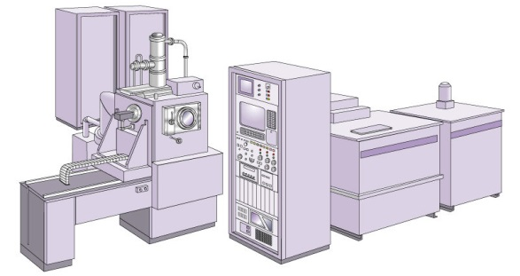
Scanning Electron Microscopes
Are high resolution microscopes which allows small items to be viewed in great detail
Use a beam of electrons reflected on an object to form an image
Allow more of a item to be focused on at a time

Slide 47
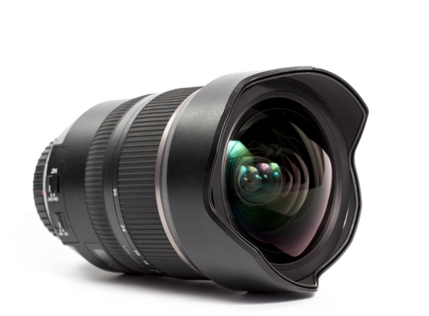
Macrophotography
Is extreme close-up photography used to document very small pieces of evidence
Captures photos with emphasis on detail which can help forensic scientists analyze evidence such as:
victim or suspect’s hair left on an object
small particles of drugs found at the crime scene
tool marks on a keyhole used in forced entry
Requires special lens and camera settings

Slide 48
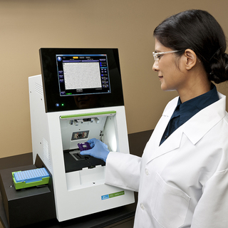
Gel Electrophoresis Apparatuses
Places biological samples in a gel and uses negative and positive charges to separate DNA molecules according to size
Allows forensic scientists to analyze DNA structures
genetic information within cells

Slide 49
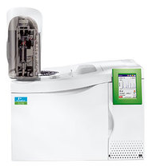
Gas Chromatographers
Are used to separate various elements of a compound by observing how they react with a specific solvent
once the components are separated they can be easily analyzed
Are used to identify:
alcohol or drug use at time of death
substances found at the crime scene which can be traced to a different location or suspect
chemicals used to set a fire

Slide 50
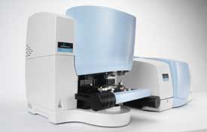
Spectroscopes
Are used to measure the intensity of light transmitted or emitted by particular substances allowing forensic scientist to identify the substance
Are used to analyze:
bodily fluids
skeletal remains
fingerprints
drugs
chemicals

Slide 51
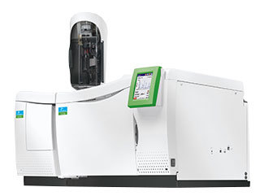
Mass Spectrometers
Are used to analyze a sample to determine its molecular makeup
Allows a sciences to separate a sample into individual ions in order to determine the samples composition
Are used to analyze extremely small pieces of evidence such as:
trace evidence
ballistic evidence
Are used to perform toxicology analysis

Slide 52
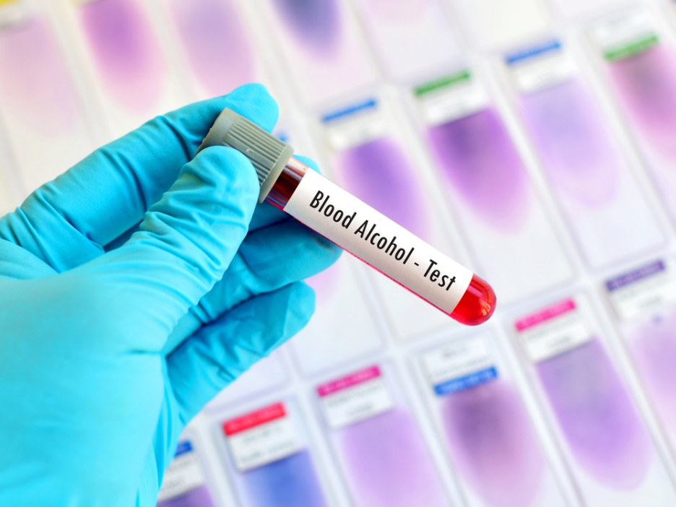
Toxicology
Is the study of chemical agents affect on living organisms
Analyzes bodily fluids for the presence of:
drug use
poisonous substances

Slide 53
Vacuum Metal Deposition
Is a technique used to develop latent prints by coating evidence with a thin layer of evaporated metal film under a high vacuum
Is used to develop prints which are damaged or found on porous surfaces

Slide 54
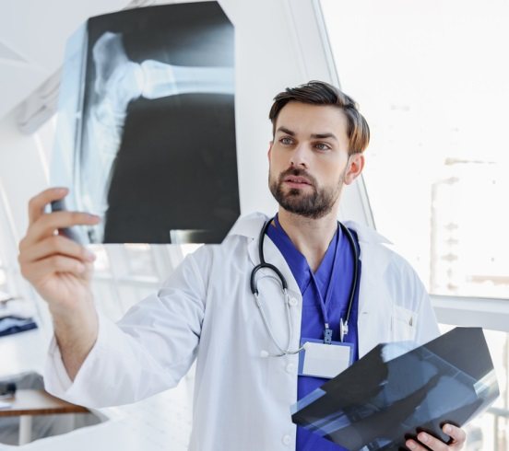
X-Ray Machines
Are used to photograph or create a digital image of the internal composition of a person or object
Are used to analyze internal evidence such as:
bullets
broken bones
bruising
debris from weapons used to harm a person

Slide 55
Trajectory Analysis Software
Uses measurements and observation to reconstruct how a shooting most likely occurred to determine the location of the shooter

Slide 56
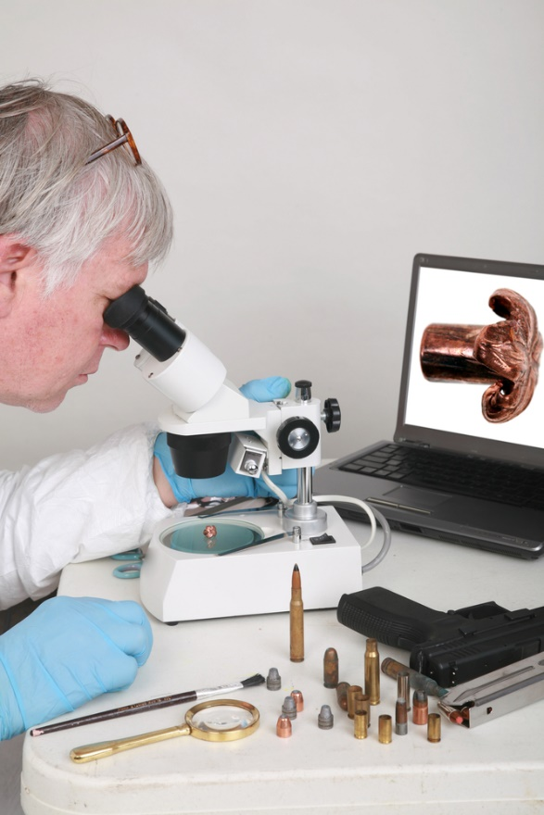
Computer Software
Are programs used to store information and create forensic science databases to easily identify:
fingerprints
DNA profiles
ballistic evidence
the identity of a criminal through facial recognition
footprints left at a crime scene

Slide 57
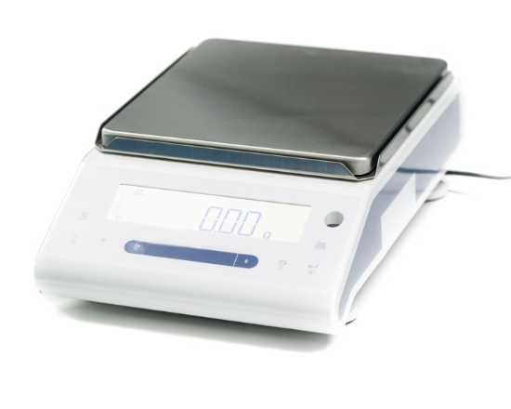
Measurement Tools
Include:
length measurement tools
thermometer
timing devices
scales
calculators
lab glassware

Slide 58
Length Measurement Tools
Are used to:
measure area of a crime scene to make proportional crime scene sketches
measure various types of evidence such as:
shoeprints
gunshot distances
blood spatter
bones of a deceased person to determine height
Include tools such as:
meter sticks
tape measure
measuring wheel

Slide 59
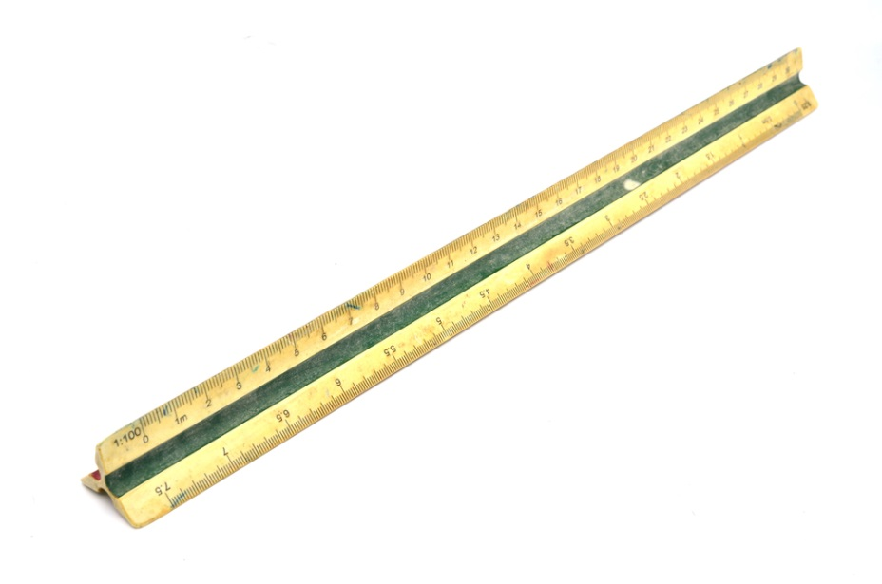
Meter Stick
Is a measuring stick one meter in length which is marked in inches, centimeters and millimeters
Is used for measuring the length of small flat pieces of evidence such as:
shoeprints
documents
handprints

Slide 60
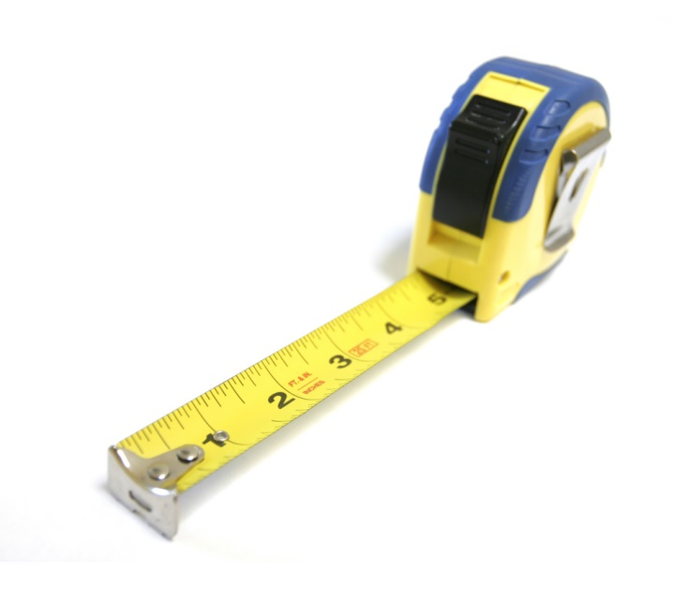
Tape Measure
Is a narrow strip of cloth or steel tape marked in inches or centimeters
Is used for measuring:
area of a crime scene
large pieces of evidence
odd shaped evidence
cloth tape measure can be wrapped around objects

Slide 61
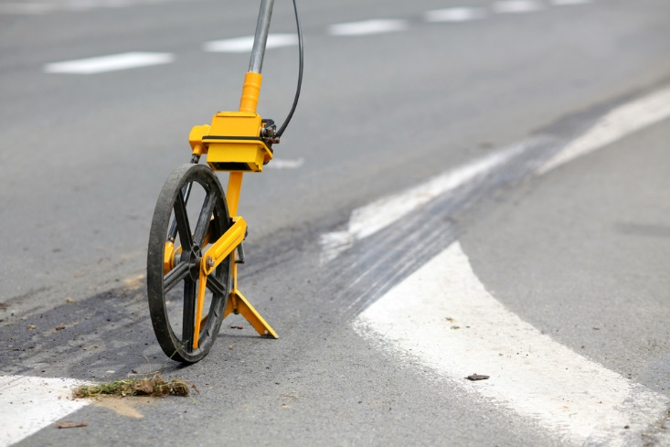
Measuring Wheel
Quickly records distance by pushing the wheel around an area or large object
Is used to record the measurements of the area of a crime scene

Slide 62
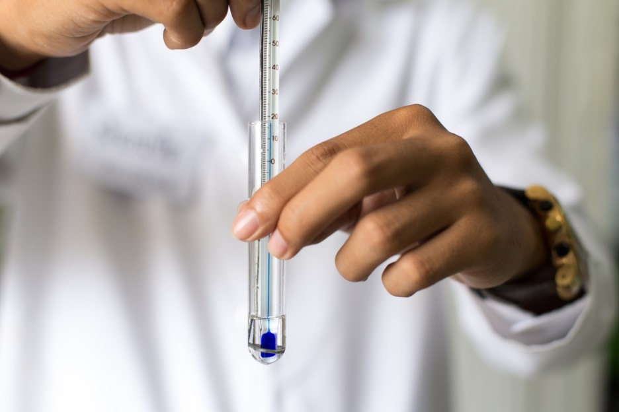
Thermometers
Are used to measure temperature of:
bodies
liquids
chemicals
gasses
environment
objects
Are used to:
determine how long a body has been deceased at a crime scene
temperature of chemicals to perform forensic science analysis in labs
temperature at a crime scene

Slide 63
Timing Devices
Are used to measure time
Are used to perform time sensitive chemical reaction tests
Include:
stopwatches and timers
clocks

Slide 64
Scales
Include:
analytical balance scales
moisture analyzers
precision scales
triple beam balance scales
ABFO scales

Slide 65
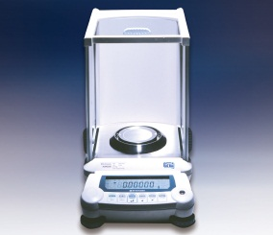
Analytical Balance Scales
Are used to measure weight with extreme sensitivity
Consist of a small weight enclosed in a box with a door to ensure dust or air currents do not affect the reading

Slide 66
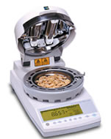
Moisture Analyzers
Are used to measure moisture content in an object
Weighs the sample before and after heat is used to evaporate moisture from the sample to determine the weight lost in drying
Are used to determine moisture levels in:
pharmaceuticals
chemicals
environmental samples
food

Slide 67
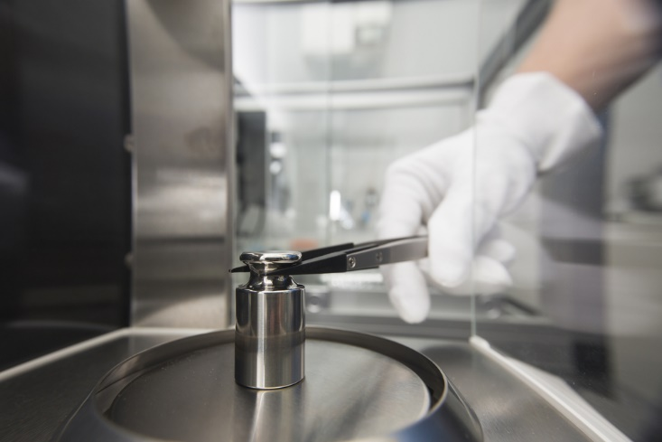
Precision Scales
Are used for complex measurements for exact weights
Are used to weight various lab samples

Slide 68
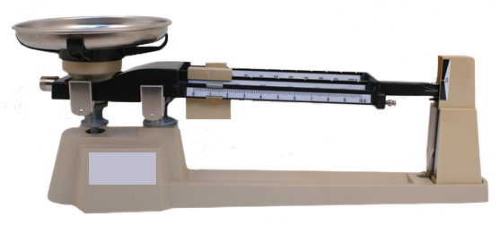
Triple Beam Balance Scales
Are scales consisting of three beams with a sliding weight in the middle which balances the weight horizontally
Consist of a pan at one end in which the object is placed
Are used for very precise measurements of mass material

Slide 69
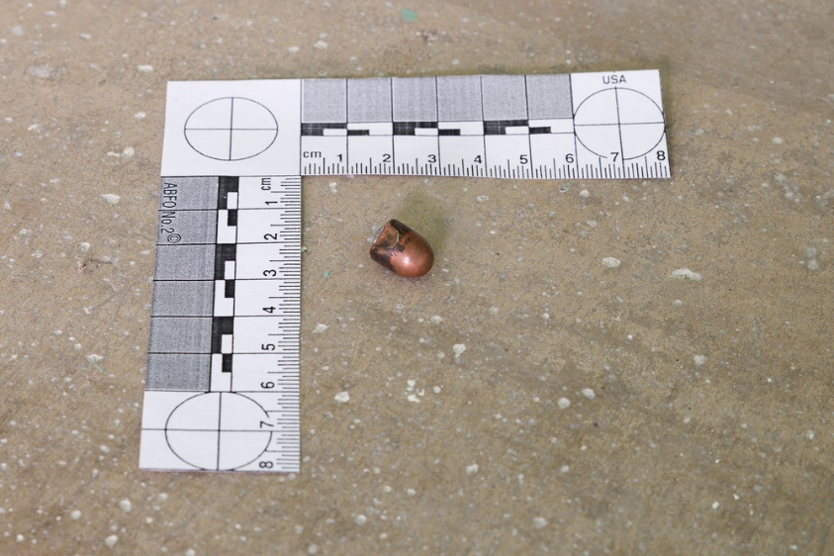
ABFO Scales
Are American Board of Forensic Odontology scales
L-shaped measuring device used in photography
Are scales used to measure length rather than weight
Are used to photograph measurements of evidence such as:
blood spatter
bite-marks
bruises
shoe prints

Slide 70
Calculators
Are used to:
collect and analyze data
analyze statistics to discover patterns
calculate measurements of evidence
Can be used to perform mathematical equation to determine:
angles at which the various blood stains struck their respective surfaces
trajectory analysis
calculate the height of a person based on the size of a bone

Slide 71
Lab Glassware
Are glass containers used to store liquids or powders for:
measuring
heating
cooling
transferring locations
mixing
pouring

Slide 72
Lab Glassware
Includes:
beakers
jars
bottles
tubes
cylinders
droppers
funnels
pipettes
vials
petri dish

Slide 73
Hot Plates
Are a flat heated surface used to:
heat samples
perform chemical reactions
Should be used with heat resistant glassware and heat protective gripping devices

Slide 74
Prepared Slides
Are flat rectangular pieces of glass which items are placed upon to be viewed under a microscope
Hold evidence with a plastic slip over the top
Should be labeled
Can display evidence such as:
hair
bodily fluids
trace evidence
Should be handled wearing gloves

Slide 75
Stereoscopes
Are devices by which two photographs of the same object are taken at slightly different angles are viewed together, creating an impression of 3-D depth

Slide 76
Micropipettes
Are a fine pointed pipette with a plunger used to measure and transfer small amounts of liquids
Are used by placing the pointed pipette end into the liquid sample and pressing down on the plunger to draw the liquid into the pipette
Pipette: a slender tube attached to a bulb used to transfer or measure out small quantities of liquid

Slide 77
Teacher Instructions:
Show the Using a Microscope video segment

Slide 79
Evidence Storing & Preservation Tools
Include:
evidence packaging
freezers and refrigerators
storage cabinets
lab incubators
evidence drying cabinets

Slide 80
Evidence Packaging
Includes appropriately packaging evidence depending on its type
Includes:
bags
boxes
envelopes
containers
Should always contain a chain of custody form

Slide 81
Freezers & Refrigerators
Are used for long term preservation of evidence
Should maintain temperature for integrity
temperature depends on type of evidence
Are used to store evidence such as:
DNA
biological specimens
bones
teeth
Should be closely monitored to ensure consistent temperature

Slide 82
Storage Cabinets
Are shelves used for storage typically placed in an evidence room or warehouse
Are used for organized safe storage of evidence

Slide 83
Lab Incubators
Provide a controlled, contaminant-free environment for storage of cell cultures
cells grown under a controlled condition
Regulates conditions such as:
temperature
humidity
carbon dioxide

Slide 84
Evidence Drying Cabinets
Are ventilated cabinets designed to store, dry or process forensic evidence in a controlled environment
Prevent cross contamination
prevents lab personnel from exposure to biohazards
protects evidence from exposure to lab chemicals

Slide 85
Resources
https://www.nij.gov/topics/law-enforcement/investigations/crime-scene/guides/pages/equipment-csi.aspx
http://www.crime-scene-investigator.net/crimesceneequipmentchecklist.html
http://www.safariland.com/products/forensics/?utm_source=bing&utm_medium=cpc&utm_campaign=Forensics&utm_term=forensic%20science%20equipment&utm_content=Forensics%20Supplies
http://www.yourgenome.org/facts/what-is-gel-electrophoresis
http://web.alfredstate.edu/benslewd/FRSC1001/Microscopy%20Handout.pdf
http://chemistry.about.com/od/chemistrylab/tp/Chemistry-Glassware-Names-and-Uses.htm
http://www.csudh.edu/oliver/demos/bal-use/bal-use.htm
http://www.sjsu.edu/people/steven.lee/courses/c2/s2/Wecht_29.pdf.
http://www.gas-chromatography.net/gas-chromatography.php

Slide 86
PowerPoint® Acknowledgements
Production Coordinator
Tylee Williams
Brand Manager
Whitney Orth
Graphic Designer
Melody Rowell
Quality Control Director
Angela Dehls
V.P. of Brand Management
Clayton Franklin
Executive Producer
Gordon W. Davis, Ph.D.

Slide 87
Video Acknowledgements
Production Coordinator
Tylee Williams
Brand Manager
Whitney Orth
Videography
Holley Baker, Mike Barley
Video Post Production
Holley Baker
Quality Control Director
Angela Dehls
Collaborator
Patrick Buzzini, Ph.D.
Associate Professor of Forensic Science
Sam Houston State University,
Institute for Forensic Research, Training & Innovation
Sarah Kerrigan, Ph.D.
Director of Sam Houston State University Institute for Forensic Research, Training & Innovation
V.P. of Brand Management
Clayton Franklin
Executive Producer
Gordon W. Davis, Ph.D.
© MMXVIII
CEV Multimedia, Ltd.

