Slide 2
Objectives
To explain the role of the U.S. Constitution in the development and implementation of law enforcement.
To discuss the mission of law enforcement in protecting a democratic society.
To analyze how citizens’ constitutional rights are protected by laws and behavior standards relating to law enforcement.

Slide 3
Main Menu
Law Enforcement & The Constitution
Officer Insight: Role of the Constitution Video Segment

Slide 4
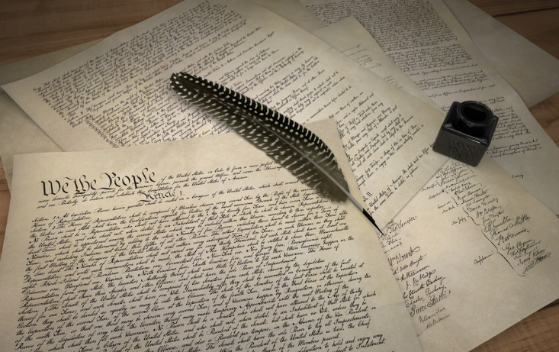
The U.S. Constitution
Embodies the fundamental principles by which the United States is governed
Includes regulations for the operation of government functions
Includes rights of individual citizens and residents
often referred to as civil rights

Slide 5
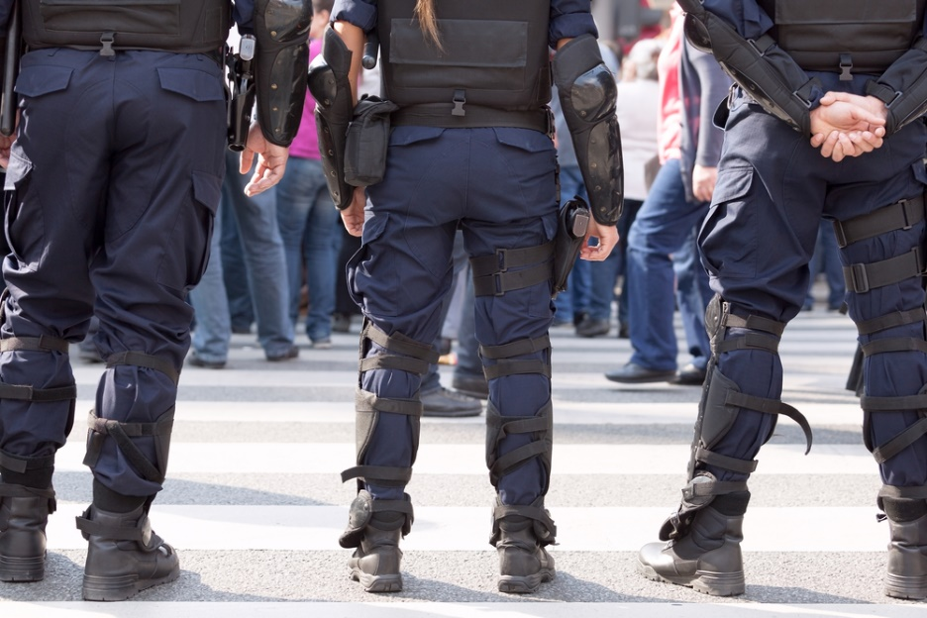
The U.S. Constitution
Does not specifically mention law enforcement
however, because it lays the foundation for creating government and order in the nation, it applies to law enforcement, whose job it is to maintain order and uphold governmental principles

Slide 6
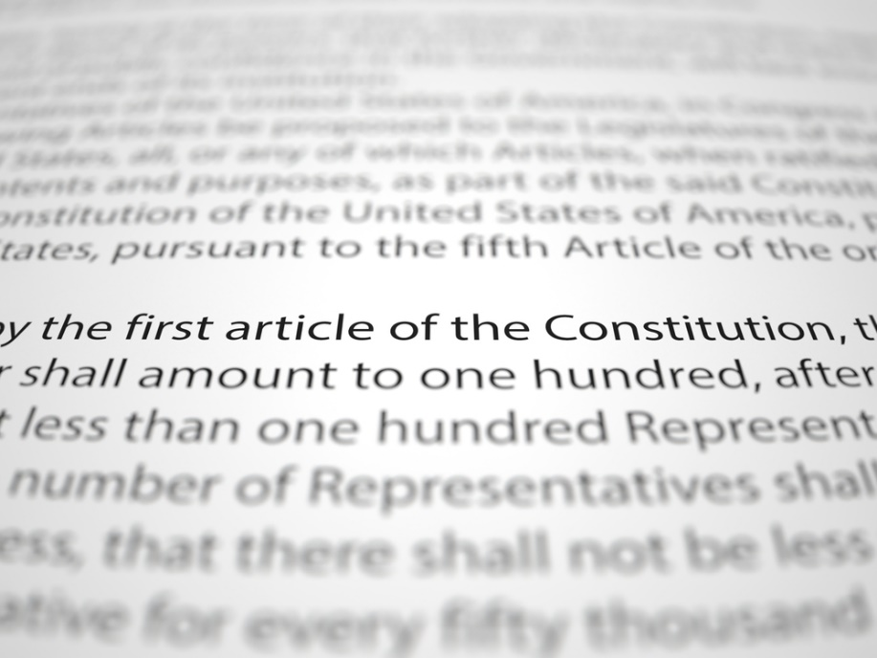
The U.S. Constitution
Consists of three distinct sections:
the Preamble
discusses the purpose of the document
the Articles
discusses structure and operation of the government
the Amendments
additions to revise, clarify or supplement Articles

Slide 7
The Preamble
Is an introductory explanation of the document, stating its purpose
“to form a more perfect Union, establish Justice, insure domestic Tranquility, provide for the common defence [sic.], promote the general Welfare, and secure the Blessings of Liberty to ourselves and our Posterity”

Slide 8
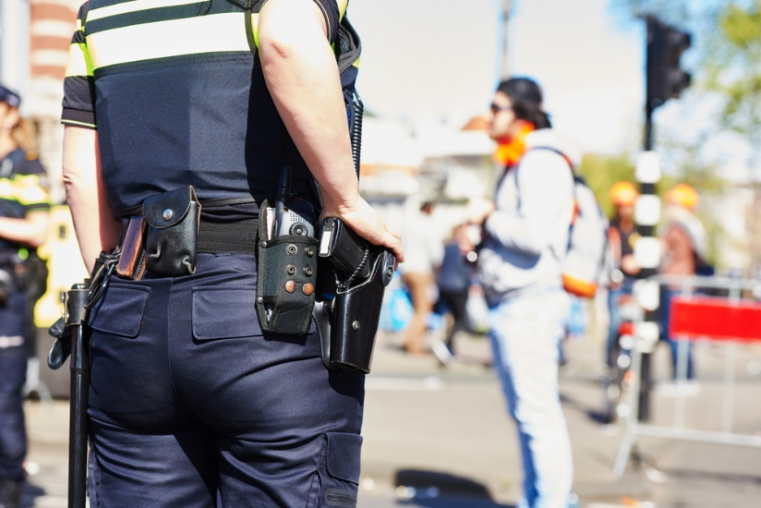
The Preamble
Relates to law enforcement because it states two of the reasons for writing the Constitution were to establish justice and insure domestic tranquility
meaning it was intended to enact laws which protect citizens, fairly prosecute offenders and prevent conflict

Slide 9
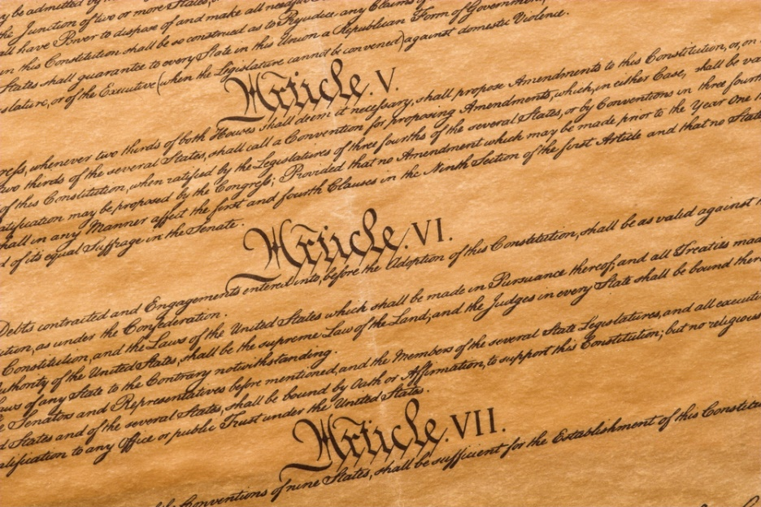
The Articles
Are the foundation of the Constitution
Provide instructions for the structure and operation of the federal government
Consist of seven articles which each serve to describe the rules regarding a specific aspect or concern

Slide 10
The Articles
Relate to law enforcement because they define areas of authority and proper procedures for implementing authority
for example:
Article Three explores roles and responsibilities of the executive branch of government, which oversees law enforcement
Article Four discusses application of laws across state lines and transfer of criminals between states
Article Six requires officers to swear to uphold the Constitution

Slide 11
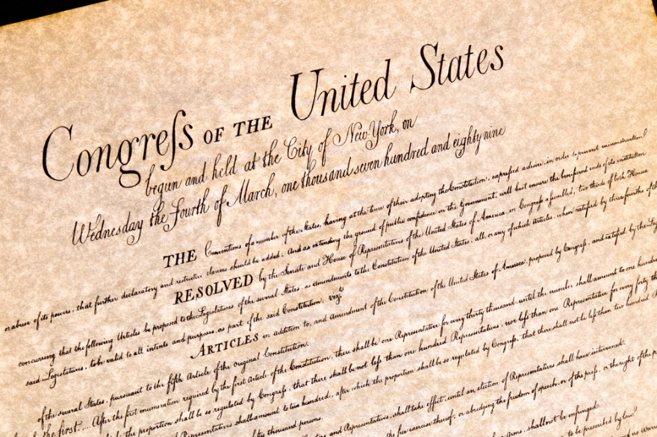
The Amendments
Are additions made to the Constitution to supplement the Articles
each explains a new, revised or clarified law for how the government should operate
Include the Bill of Rights
first ten amendments
protect individuals’ basic rights by prohibiting the government and its officials from infringing on them

Slide 12
Amendments
Relate to law enforcement for two reasons:
some of them explain rights of individuals police must respect
particularly the Bill of Rights and the 14th Amendment
some of them clarify or change laws and governmental procedures which affect police

Slide 13
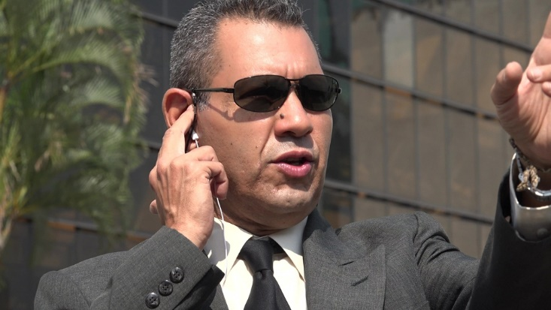
Law Enforcement
Is more directly governed by state and local constitutions
many of these specifically mention law enforcement’s role in maintaining governmental principles

Slide 14
State Constitutions
Guide each state’s governmental structure and processes
every state has its own constitution which details how it handles the powers it is granted by the 10th Amendment
says all powers not expressly granted to the federal government in the U.S. Constitution are reserved to the states or the people
May also include additional civil rights not mentioned in the U.S. Constitution

Slide 15
State Constitutions
Are typically longer than the U.S. Constitution
average 26,000 words
compared to less than 9,000 words in the U.S. Constitution
average of 115 Amendments
compared to the 27 Amendments in the U.S. Constitution

Slide 16
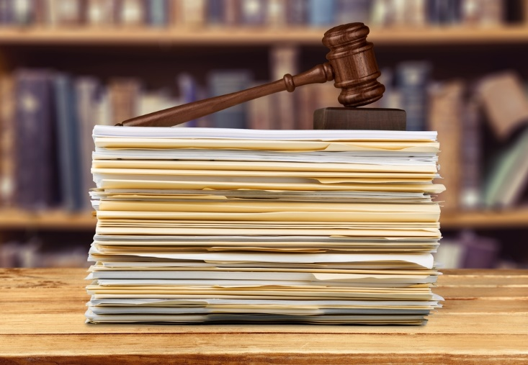
Local Constitutions
Exist in some cities, counties, etc.
depending on how the state constitution grants powers to localities
May not always be formally called constitutions
often they are called charters or codes or they may be simply referred to as legislation, laws, statues or ordinances

Slide 17
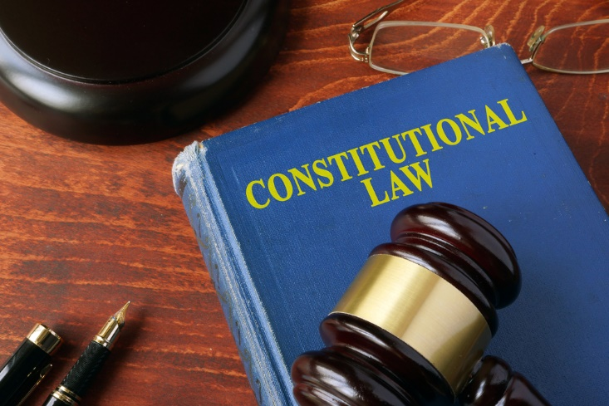
All Constitutional Laws
Are established to provide governmental officials rules and guidelines for appropriate and effective functioning
including law enforcement

Slide 18
All Constitutional Laws
Are established to protect citizens and residents from over-reaching governments and undesirable people and practices
the Bill of Rights and states’ Bills of Rights prohibit authority (including law enforcement) from abusing power to limit freedoms
officers cannot search a suspect’s property without a warrant or probable cause
officers must inform detained suspects of their 5th and 6th Amendment rights

Slide 19
Law Enforcement
Plays a significant role in protecting a democratic society
motivates individuals to behave in a civil, ethical and responsible manner
holds offensive and oppressive individuals accountable for wrongdoing
contributes to legal processes and institutions which uphold democracy’s core values
Democratic Society – society in which all members have meaningful rights and opportunities to express opinions and participate in decision-making processes

Slide 20
Law Enforcement
Was developed to ensure the following:
individuals abide by the U.S. Constitution, state and local constitutions, and other laws
by detecting and deterring criminal activity
by maintaining peace, order and the public’s safety
those who do not comply with constitutions and laws are held accountable
by ticketing, arresting and/or detaining suspects

Slide 21
Law Enforcement
Has many responsibilities which contribute to democratic society
providing security for public officials
maintaining safety and order at public events, including political rallies and protests
ensuring laws voted in by the majority are followed by all
preventing individuals from threatening others’ freedoms and protecting individuals whose freedoms are threatened

Slide 22
Law
Is implemented to protect health and safety while honoring constitutional rights
to maintain a functioning society, people must be willing to sacrifice some freedoms
for example, people cannot be free to murder because it infringes on the freedom of victims

Slide 23
Law Enforcement
Is responsible for maintaining the balance between freedom and safety
for example, the 4th Amendment protects against unreasonable search and seizure, but when a police officer detains a suspect, the suspect may be searched to protect the safety of the officer
as decided in the Supreme Court case, Terry v. Ohio (1968)

Slide 24
Law Enforcement Officers
Are given significant power and authority to accomplish this balance
due to the power they are granted, it is important for officers to receive proper training to develop appropriate knowledge and skills
programs vary, but generally cover basic legal concepts and police procedures
Fun Fact: Powers and authority are granted to officers by the states, based on the 10th Amendment.

Slide 25
Law Enforcement Officers
Must take an oath of office as stated in Article Six of the Constitution
wording varies, but generally includes a promise to:
faithfully perform duties
support, obey and defend the U.S. Constitution, as well as other laws

Slide 26
Law Enforcement Officers
Should have knowledge of the Constitution to fully meet the expectations of their oath
its history, structure and content
especially constitutional rights found in the Bill of Rights and other amendments
Should comply with standards to respect people’s constitutional rights
regardless of the person or situation

Slide 27
Law Enforcement Standards
Are intended to protect citizens’ constitutional rights
Include legal standards
against the law to violate
officers who violate could be arrested and prosecuted in court
Include ethical standards
generally not accepted by employers and society
officers who violate could be fired, sued or shamed

Slide 28
Law Enforcement Standards
Are evaluated often to verify they are appropriate and best suited to meeting the goals of law enforcement
protect constitutional rights
provide for safety of officers and citizens
allow officers to effectively perform their jobs

Slide 29
Law Enforcement Standards
Are evaluated by:
law enforcement agencies
through internal reviews and policy reform
local, state and federal court systems
through civil and criminal court cases
public opinion and media
through public discussion and media publications

Slide 30
Teacher Instructions:
Show the Officer Insight: Role of the Constitution video segment

Slide 31
Resources
http://www.utahstatetrooper.com/law-enforcement-and-the-united-states-constitution/
http://kids.laws.com/
https://www.britannica.com/topic/police-power
http://www.slu.edu/colleges/law/journal/police-use-of-deadly-force-state-statues-30-years-after-garner/

Slide 32
Acknowledgements
Brand Manager
Amy Hogan
Graphics Editor
Melody Rowell
Video Post Production
Taren Perkins
Quality Control Director
Angela Dehls
V.P. of Brand Management
Clayton Franklin
Executive Producer
Gordon W. Davis, Ph.D.
© MMXVII
CEV Multimedia, Ltd.

